Slide 1


An In-Depth Look at the 2015-2020 Dietary Guidelines
Information adapted from the 2015-2020 Dietary Guidelines for Americans. Available at DietaryGuidelines.gov.
Notes:
Available at: DietaryGuidelines.gov
The 2015-2020 Dietary Guidelines is available exclusively on DietaryGuidelines.gov.
Suggested Citation
U.S. Department of Health and Human Services and U.S. Department of Agriculture. 2015 – 2020 Dietary Guidelines for Americans. 8th Edition. December 2015. Available at http://health.gov/dietaryguidelines/2015/guidelines/.

Slide 2


Presentation Objectives
Provide an in-depth look at the 2015-2020 Dietary Guidelines for Americans
Highlight informative charts and figures

Slide 3
Introduction
Notes:
Every 5 years since 1980, a new edition of the Dietary Guidelines for Americans has been published. Its goal is to make recommendations about the components of a healthy and nutritionally adequate diet to help promote health and prevent chronic disease for current and future generations. Although many of its recommendations have remained relatively consistent over time, the Dietary Guidelines has evolved as scientific knowledge has grown. These advancements have provided a greater understanding of, and focus on, the importance of healthy eating patterns as a whole, and how foods and beverages act synergistically to affect health. Therefore, healthy eating patterns is a focus of the 2015-2020 Dietary Guidelines.

Slide 4
Nutrition and Health Are Closely Related
“About half of all American adults—117 million individuals—have one or more preventable chronic diseases, many of which are related to poor eating and physical activity patterns.”
Notes:
About half of all American adults—117 million individuals—have one or more preventable chronic diseases, many of which are related to poor quality eating patterns and physical inactivity. These include cardiovascular disease, high blood pressure, type 2 diabetes, some cancers, and poor bone health. More than two-thirds of adults and nearly one-third of children and youth are overweight or obese. These high rates of overweight and obesity and chronic disease have persisted for more than two decades and come not only with increased health risks, but also at high cost. In 2008, the medical costs associated with obesity were estimated to be $147 billion. In 2012, the total estimated cost of diagnosed diabetes was $245 billion, including $176 billion in direct medical costs and $69 billion in decreased productivity.
[See Table I-1 for additional facts about Nutrition- and Physical Activity-Related Health Conditions in the United States.]

Slide 5
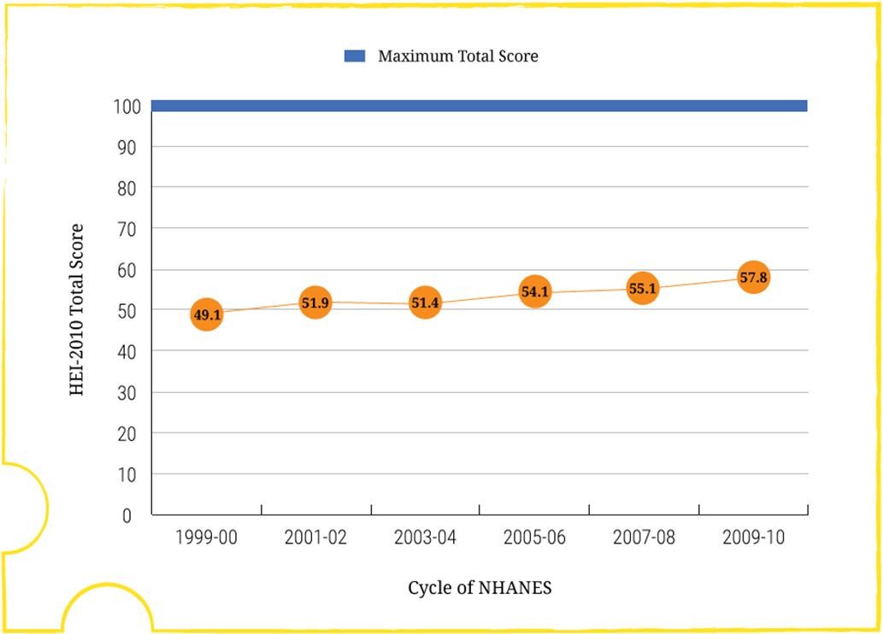
Adherence to the 2010 Dietary Guidelines
Measured by Average Total Healthy Eating Index-2010 (HEI-2010) Scores of the U.S. Population Ages 2 Years and Older (Figure I-1)
Data Source: Analyses of What We Eat in America, National Health and Nutrition Examination Survey (NHANES) data from 1999-2000 through 2009-2010.
Note: HEI-2010 total scores are out of 100 possible points. A score of 100 indicates that recommendations on average were met or exceeded. A higher total score indicates a higher quality diet.
Notes:
Concurrent with these diet-related health problems persisting at high levels, trends in food intake over time show that, at the population level, Americans are not consuming healthy eating patterns. For example, the prevalence of overweight and obesity has risen and remained high for the past 25 years, while Healthy Eating Index (HEI) scores, a measure of how food choices align with the Dietary Guidelines, have remained low (Figure I-1).

Slide 6
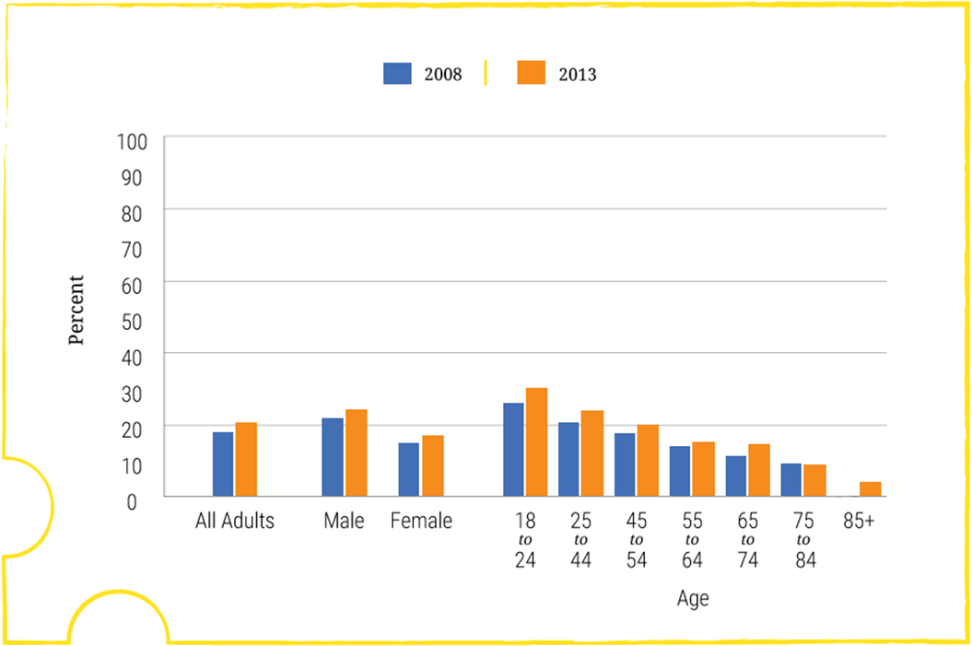
Adherence to the Physical Activity Guidelines
Percentage of Adults Meeting the Aerobic and Muscle-Strengthening Recommendations (Figure I-2)
Data Source:
Analyses of the National Health Interview Survey, 2008 and 2013.
Healthy People 2020 PA-2.4. Increase the proportion of adults who meet the objectives for aerobic physical activity and for muscle-strengthening activity. Washington, DC: U.S. Department of Health and Human Services, Office of Disease Prevention and Health Promotion, June 3, 2015. Available at: http://www.healthypeople.gov/2020/data-search/Search-the-Data?nid=5072.
Notes:
Similarly, physical activity levels have remained low over time (Figure I-2). The continued high rates of overweight and obesity and low levels of progress toward meeting Dietary Guidelines recommendations highlight the need to improve dietary and physical activity education and behaviors across the U.S. population.
Progress in reversing these trends will require comprehensive and coordinated strategies, built on the Dietary Guidelines as the scientific foundation, that can be maintained over time. The Dietary Guidelines is an important part of a complex and multifaceted solution to promoting health and helping to reduce the risk of chronic disease.

Slide 7

The Dietary Guidelines for Americans:
What It Is, What It Is Not
Provide evidence-based recommendations about the components of a healthy and nutritionally adequate diet
Focus on disease prevention rather than disease treatment
Inform Federal food, nutrition, and health policies and programs
Notes:
The main purpose of the Dietary Guidelines is to inform the development of Federal food, nutrition, and health policies and programs. It is written for policymakers, as well as nutrition and health professionals, not the general public. The Dietary Guidelines is a critical tool for professionals to help Americans make healthy choices in their daily lives to help prevent chronic disease and enjoy a healthy diet.
Its recommendations are ultimately intended to help individuals improve and maintain overall health and reduce the risk of chronic disease—its focus is disease prevention. The Dietary Guidelines is not intended to be used to treat disease.
Regardless of an individual’s current health status, almost all people in the United States could benefit from shifting choices to better support healthy eating patterns. Thus, the Dietary Guidelines may be used or adapted by medical and nutrition professionals to encourage healthy eating patterns to patients.
[Additional Background:
The main purpose of the Dietary Guidelines is to inform the development of Federal food, nutrition, and health policies and programs. It serves as the evidence-based foundation for nutrition education materials that are developed by the Federal Government for the public. For example, Federal dietary guidance publications are required by law to be consistent with the Dietary Guidelines. It also is used to inform USDA and HHS food programs, such as USDA's National School Lunch Program and School Breakfast Program, which feed more than 30 million children each school day, and the Special Supplemental Nutrition Program for Women, Infants and Children, which uses the Dietary Guidelines as the scientific underpinning for its food packages and nutrition education program with about 8 million beneficiaries. In HHS, the Administration on Aging implements the Dietary Guidelines through the Older Americans Act Nutrition Services programs (i.e., nutrition programs for older adults), with about 5,000 community-based nutrition service providers who together serve more than 900,000 meals a day across the United States. Other Departments, such as the Department of Defense and the Department of Veterans Affairs, also use the Dietary Guidelines to inform programs. ]

Slide 8
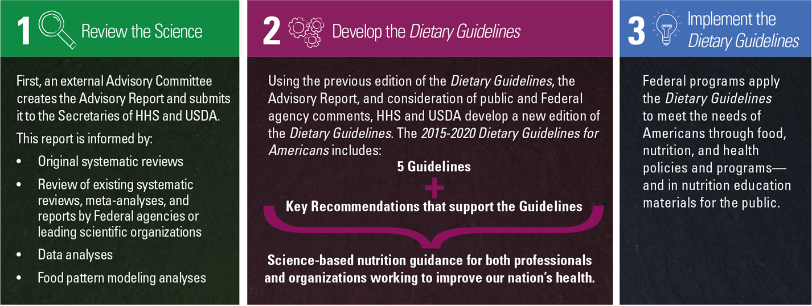
Developing the Dietary Guidelines for Americans
(Figure I-3)
Notes:
Creating each edition of the Dietary Guidelines is a joint effort of HHS and USDA. A new edition is published every 5 years to reflect advancements in scientific knowledge and translate the science current at the time into sound food-based guidance to promote health in the United States. The process to develop the Dietary Guidelines has also evolved and includes three stages.
In the first stage, the Secretaries of HHS and of USDA appoint an external Dietary Guidelines Advisory Committee (Advisory Committee). Their role is to provide advice and recommendations to the Federal Government on the current state of scientific evidence on nutrition and health. The 2015 Advisory Committee was charged with reviewing the 2010 edition of the Dietary Guidelines to determine the topics for which new scientific evidence was likely to be available, and to review that evidence to inform the development of the 2015-2020 edition.
The 2015 Advisory Committee used four state-of-the-art approaches to review and analyze the available evidence: original systematic reviews; existing systematic reviews, meta-analyses, and reports by Federal agencies or leading scientific organizations; data analyses; and food pattern modeling analyses. Most of its conclusion statements on nutrition and health were informed by systematic reviews, which are a gold standard for informing clinical practice guidelines and public health policies worldwide. This multifaceted approach allowed the Advisory Committee to ask and answer scientific questions about the relationship of diet and health to systematically, objectively, and transparently synthesize research findings and to limit bias in its evaluation of the totality of the evidence for the topics it reviewed. This approach also allowed one or more methods to be used that were best suited to comprehensively answer each question.
The Advisory Committee’s work culminated in the Scientific Report of the 2015 Dietary Guidelines Advisory Committee, which was submitted to the Secretaries of HHS and of USDA and made available for public and agency comment in February 2015. For more information about the Advisory Committee and its review process and Advisory Report, visit DietaryGuidelines.gov.
In the second stage, HHS and USDA develop the policy document Dietary Guidelines, applying several process steps to promote scientific rigor. Similar to previous editions, this 8th edition builds upon the preceding edition, with the scientific justification for revisions informed by the Advisory Committee’s report and consideration of public and Federal agency comments. Comments on the Advisory Committee’s report are considered in the development of the policy document, placing emphasis on those with scientific justification while ensuring that the policy is based on the totality of the evidence and not on individual studies. After the Advisory Committee’s report is complete, Federal agencies provide comments regarding the applicability and rigor of the report for consideration in translating the science into policy.
Those who update the policy document are Federal experts with specialized knowledge in the evidence under consideration and its policy applications within the Federal Government. These policy writers include nutrition scientists, policy experts, and communications specialists. Consultation with other Federal experts occurs throughout the policy development process. A peer-review step also is completed, in which nonfederal experts independently conduct a confidential review of the draft policy document for clarity and technical accuracy of the translation of the evidence from the Advisory Report into policy language. In addition, extensive review and clearance of the policy document also occurs by Federal experts within the agencies of both Departments, such as the Centers for Disease Control and Prevention (CDC), the National Institutes of Health (NIH), the Food and Drug Administration (FDA), and the USDA Food Safety and Inspection Service (FSIS). The Federal clearance of the policy document culminates with review and approval by the Secretaries of HHS and of USDA.
The 2015-2020 Dietary Guidelines is built around five Guidelines with supporting Key Recommendations that provide detail on the elements of healthy eating patterns. The Key Recommendations represent the preponderance of the most current scientific evidence. Emphasis is placed on topics with the strongest evidence or public health need.
In the third and final stage, the Federal Government implements the recommendations in the Dietary Guidelines. Federal programs apply the Dietary Guidelines to meet the needs of Americans and specific population groups through food, nutrition, and health policies and programs and in nutrition education materials for the public. Although the Dietary Guidelines provides the foundation for Federal nutrition and health initiatives, it is each Federal agency’s purview and responsibility to determine how best to implement the Dietary Guidelines to serve its specific audiences. One way USDA and other Federal agencies can implement the Dietary Guidelines is through MyPlate, which serves as a reminder to build healthy eating patterns by making healthy choices across the food groups. In addition to implementation by the Federal Government and as discussed in Chapter 3, ample opportunities exist for many other sectors of society to implement the Dietary Guidelines in the multiple settings they influence, from home to school to work to community.

Slide 9
A Roadmap to the
2015-2020 Edition of the
Dietary Guidelines for Americans
Notes:
Chapter 1 of the policy document describes the key elements of healthy eating patterns

Slide 10
2015-2020 Dietary Guidelines for Americans:
Contents
Executive Summary
Introduction
Chapter 1: Key Elements of Healthy Eating Patterns
Chapter 2: Shifts Needed to Align With Healthy Eating Patterns
Chapter 3: Everyone Has a Role in Supporting Healthy Eating Patterns
Appendixes
Notes:
People do not eat foods and nutrients in isolation but in combination, and this combination forms an overall eating pattern. A growing body of research has examined the relationship between overall eating patterns, health, and risk of chronic disease, and findings on these relationships are sufficiently well established to support dietary guidance. As a result, eating patterns and their food and nutrient characteristics are a primary emphasis of the recommendations in this 2015-2020 edition of the Dietary Guidelines. This edition of the Dietary Guidelines consists of an Introduction, three chapters, and 14 appendixes.

Slide 11
2015-2020 Dietary Guidelines for Americans:
The Guidelines
Follow a healthy eating pattern across the lifespan. All food and beverage choices matter. Choose a healthy eating pattern at an appropriate calorie level to help achieve and maintain a healthy body weight, support nutrient adequacy, and reduce the risk of chronic disease.
Focus on variety, nutrient density, and amount. To meet nutrient needs within calorie limits, choose a variety of nutrient-dense foods across and within all food groups in recommended amounts.
Limit calories from added sugars and saturated fats and reduce sodium intake. Consume an eating pattern low in added sugars, saturated fats, and sodium. Cut back on foods and beverages higher in these components to amounts that fit within healthy eating patterns.
Notes:
The 2015-2020 Dietary Guidelines for Americans provides five overarching Guidelines that encourage healthy eating patterns, recognize that individuals will need to make shifts in their food and beverage choices to achieve a healthy pattern, and acknowledge that all segments of our society have a role to play in supporting healthy choices.

Slide 12
2015-2020 Dietary Guidelines for Americans:
The Guidelines (cont.)
Shift to healthier food and beverage choices. Choose nutrient-dense foods and beverages across and within all food groups in place of less healthy choices. Consider cultural and personal preferences to make these shifts easier to accomplish and maintain.
Support healthy eating patterns for all. Everyone has a role in helping to create and support healthy eating patterns in multiple settings nationwide, from home to school to work to communities.
Notes:
The 2015-2020 Dietary Guidelines for Americans provides five overarching Guidelines that encourage healthy eating patterns, recognize that individuals will need to make shifts in their food and beverage choices to achieve a healthy pattern, and acknowledge that all segments of our society have a role to play in supporting healthy choices.

Slide 13
CHAPTER 1:
Key Elements of Healthy Eating Patterns
Notes:
Chapter 1 of the policy document describes the key elements of healthy eating patterns

Slide 14
Key Elements of Healthy Eating Patterns:
The Guidelines
Follow a healthy eating pattern across the lifespan. All food and beverage choices matter. Choose a healthy eating pattern at an appropriate calorie level to help achieve and maintain a healthy body weight, support nutrient adequacy, and reduce the risk of chronic disease.
Focus on variety, nutrient density, and amount. To meet nutrient needs within calorie limits, choose a variety of nutrient-dense foods across and within all food groups in recommended amounts.
Limit calories from added sugars and saturated fats and reduce sodium intake. Consume an eating pattern low in added sugars, saturated fats, and sodium. Cut back on foods and beverages higher in these components to amounts that fit within healthy eating patterns.
Notes:
Chapter 1 focuses on the first 3 of these five dietary guidelines, which are:
Follow a healthy eating pattern across the lifespan. All food and beverage choices matter. Choose a healthy eating pattern at an appropriate calorie level to help achieve and maintain a healthy body weight, support nutrient adequacy, and reduce the risk of chronic disease.
Focus on variety, nutrient density, and amount. To meet nutrient needs within calorie limits, choose a variety of nutrient-dense foods across and within all food groups in recommended amounts.
Limit calories from added sugars and saturated fats and reduce sodium intake. Consume an eating pattern low in added sugars, saturated fats, and sodium. Cut back on foods and beverages higher in these components to amounts that fit within healthy eating patterns.

Slide 15
Key Elements of Healthy Eating Patterns:
Key Recommendations
Consume a healthy eating pattern that accounts for all foods and beverages within an appropriate calorie level.
A healthy eating pattern includes:
A variety of vegetables from all of the subgroups—dark green, red and orange, legumes (beans and peas), starchy, and other
Fruits, especially whole fruits
Grains, at least half of which are whole grains
Fat-free or low-fat dairy, including milk, yogurt, cheese, and/or fortified soy beverages
A variety of protein foods, including seafood, lean meats and poultry, eggs, legumes (beans and peas), and nuts, seeds, and soy products
Oils
A healthy eating pattern limits:
Saturated fats and trans fats, added sugars, and sodium
Notes:
These five Guidelines are supplemented with a number of Key Recommendations that provide more specific guidance on healthy eating patterns.
The Dietary Guidelines’ Key Recommendations for healthy eating patterns should be applied in their entirety, given the interconnected relationship that each dietary component can have with others.
Consume a healthy eating pattern that accounts for all foods and beverages within an appropriate calorie level.
A healthy eating pattern includes:
A variety of vegetables from all of the subgroups—dark green, red and orange, legumes (beans and peas), starchy, and other
Fruits, especially whole fruits [Whole fruits include fresh, canned, dried, or frozen fruits.]
Grains, at least half of which are whole grains [When refined grains are chosen, they should be enriched.]
Fat-free or low-fat dairy, including milk, yogurt, cheese, and/or fortified soy beverages [Increasing the proportion of dairy intake that is fat-free or low-fat milk or yogurt and decreasing the proportion that is cheese would decrease saturated fats and sodium and increase potassium, vitamin A, and vitamin D provided from the dairy group.]
A variety of protein foods, including seafood, lean meats and poultry, eggs, legumes (beans and peas), and nuts, seeds, and soy products
Oils [Oils include: canola, corn, olive, peanut, safflower, soybean, and sunflower oils. Oils also are naturally present in nuts, seeds, seafood, olives, and avocados.]
A healthy eating pattern limits: Saturated fats and trans fats, added sugars, and sodium [More information about these components to limit is provided on the next slide.]

Slide 16
Key Elements of Healthy Eating Patterns:
Key Recommendations (cont.)
Key Recommendations that are quantitative are provided for several components of the diet that should be limited. These components are of particular public health concern in the United States, and the specified limits can help individuals achieve healthy eating patterns within calorie limits:
Consume less than 10 percent of calories per day from added sugars
Consume less than 10 percent of calories per day from saturated fats
Consume less than 2,300 milligrams (mg) per day of sodium
If alcohol is consumed, it should be consumed in moderation—up to one drink per day for women and up to two drinks per day for men—and only by adults of legal drinking age
Meet the Physical Activity Guidelines for Americans
Notes:
Chapter 1 also includes discussion of the quantitative Key Recommendations for several components of the diet that should be limited. These components are of particular public health concern in the United States, and the specified limits can help individuals achieve healthy eating patterns within calorie limits:
Consume less than 10 percent of calories per day from added sugars. [The added sugars recommendation is a target based on food pattern modeling and national data on intakes of calories from added sugars. This target demonstrates the public health need to limit calories from added sugars to meet food group and nutrient needs within calorie limits. When added sugars exceed 10% of calories, a healthy eating pattern may be difficult to achieve.]
Consume less than 10 percent of calories per day from saturated fats. [The recommendation to consume less than 10 percent of calories per day as saturated fats is a target based on evidence that replacing saturated fats with unsaturated fats is associated with reduced risk of cardiovascular disease. However, replacing saturated fats with carbohydrates is not associated with reduced risk of cardiovascular disease.]
Consume less than 2,300 milligrams per day of sodium. [Americans are encouraged to follow the age- and sex-appropriate Tolerable Upper Intake Levels (ULs) for sodium set by the Institute of Medicine. The UL is 2,300 milligrams per day for individuals ages 14 years and older. The recommendations for children younger than 14 years of age are the IOM age- and sex-appropriate ULs {which vary from 1,500 to 2,200, depending on age}. For adults with hypertension or prehypertension, further reduction to 1,500 mg per day can result in greater blood pressure reduction.]
If alcohol is consumed, it should be consumed in moderation—up to one drink per day for women and up to two drinks per day for men—and only by adults of legal drinking age. [It is not recommended that individuals begin drinking or drink more for any reason, and there are many circumstances in which individuals should not drink, such as during pregnancy.]
In tandem with these recommendations, Americans of all ages—children, adolescents, adults, and older adults—should meet the Physical Activity Guidelines for Americans to help promote health and reduce the risk of chronic disease.
And, Americans should aim to achieve and maintain a healthy body weight.

Slide 17
Principles of Healthy Eating Patterns
An eating pattern represents the totality of all foods and beverages consumed
  It is more than the sum of its parts; the totality of what individuals habitually eat and drink act synergistically in relation to health.
Nutritional needs should be met primarily from foods
  Individuals should aim to meet their nutrient needs through healthy eating patterns that include foods in nutrient-dense forms.
Healthy eating patterns are adaptable
  Any eating pattern can be tailored to the individual’s socio-cultural and personal preferences.
Notes:
The 2015-2020 Dietary Guidelines for Americans reflects for the first time a robust body of scientific evidence on overall eating patterns and chronic disease.
Healthy eating patterns support a healthy body weight and can help prevent and reduce the risk of chronic disease throughout periods of growth, development, and aging as well as during pregnancy. The following principles apply to meeting the Key Recommendations:
An eating pattern represents the totality of all foods and beverages consumed. All foods consumed as part of a healthy eating pattern fit together like a puzzle to meet nutritional needs without exceeding limits, such as those for saturated fats, added sugars, sodium, and total calories. All forms of foods, including fresh, canned, dried, and frozen, can be included in healthy eating patterns. Eating patterns are more than the sum of their parts and may be more predictive of overall health and disease risk than individual foods or nutrients.
Nutritional needs should be met primarily from foods. Individuals should aim to meet their nutrient needs through healthy eating patterns that include nutrient-dense foods. Foods in nutrient-dense forms contain essential vitamins and minerals and also dietary fiber and other naturally occurring substances that may have positive health effects. In some cases, fortified foods and dietary supplements may be useful in providing one or more nutrients that otherwise may be consumed in less than recommended amounts.
Healthy eating patterns are adaptable. Individuals have more than one way to achieve a healthy eating pattern. Any eating pattern can be tailored to the individual’s socio-cultural and personal preferences.
There is more than one type of healthy eating pattern. The 2015-2020 Dietary Guidelines embodies the idea that a healthy eating pattern is not a rigid prescription, but rather, an adaptable framework in which individuals can enjoy foods that meet their personal, cultural, and traditional preferences and fit within their budget.

Slide 18
The Science Behind Healthy Eating Patterns
Systematic reviews of scientific research
  To examine relationships between the overall eating pattern, including its constituent foods, beverages, and nutrients, and health outcomes.
Food pattern modeling
  To assess how well various combinations and amounts of foods from all food groups would result in healthy eating patterns that meet nutrient needs and accommodate limits, such as those for saturated fats, added sugars, and sodium.
Analyses of current intakes
  To identify areas of potential public health concern.
Notes:
The components of healthy eating patterns recommended in this edition of the Dietary Guidelines were developed by integrating findings from systematic reviews of scientific research, food pattern modeling, and analyses of current intake of the U.S. population:
Systematic reviews of scientific research examine relationships between the overall diet, including its constituent foods, beverages, and nutrients, and health outcomes.
Food pattern modeling assesses how well various combinations and amounts of foods from all food groups would result in healthy eating patterns that meet nutrient needs and accommodate limits, such as those for saturated fats, added sugars, and sodium.
Analyses of current intakes identify areas of potential public health concern.
Together, these complementary approaches provide a robust evidence base for healthy eating patterns that both reduce risk of diet-related chronic disease and ensure nutrient adequacy

Slide 19
Inside Healthy Eating Patterns:
Food Groups
“Eating an appropriate mix of foods from the food groups and subgroups—within an appropriate calorie level—is important to promote health.”
Each food group and subgroup provides an array of nutrients.
Recommended amounts reflect eating patterns associated with positive health outcomes.
Foods from all of the food groups should be eaten in nutrient-dense forms.
Notes:
The 2015-2020 Dietary Guidelines notes that eating an appropriate mix of foods from the food groups and subgroups—within an appropriate calorie level—is important to promote health.
Each of the food groups (vegetables, fruits, grains, dairy, and protein foods) and their subgroups provides an array of nutrients, and the amounts recommended reflect eating patterns that have been associated with positive health outcomes.
Foods from all of the food groups should be eaten in nutrient-dense forms.
The Guidelines describes the recommendations for each of the food groups, highlights nutrients for which the food group is a key contributor, and describes special considerations related to the food group.

Slide 20
Inside Healthy Eating Patterns:
Food Groups — Examples of Content
Vegetables
Dairy
Healthy eating patterns include a variety of vegetables from all five vegetable subgroups—dark green, red and orange, legumes (beans and peas), starchy, and other.
Include all fresh, frozen, canned, and dried options in cooked or raw forms, including vegetable juices.
Vegetables should be consumed in a nutrient-dense form, with limited additions such as salt, butter, or creamy sauces.
Healthy eating patterns include fat-free and low-fat (1%) dairy, including milk, yogurt, cheese, or fortified soy beverages (soymilk).
Fat-free or low-fat milk and yogurt, in comparison to cheese, contain less saturated fats and sodium and more potassium, vitamin A, and vitamin D.
Notes:
These are examples of a little of the information provided for two of the food groups, vegetables and dairy.
Vegetables
Healthy eating patterns include a variety of vegetables from all of the five vegetable subgroups—dark green, red and orange, legumes (beans and peas), starchy, and other.
These include all fresh, frozen, canned, and dried options in cooked or raw forms, including vegetable juices.
Vegetables should be consumed in a nutrient-dense form, with limited additions such as salt, butter, or creamy sauces.
Dairy
Healthy eating patterns include fat-free and low-fat (1%) dairy, including milk, yogurt, cheese, or fortified soy beverages (commonly known as “soymilk”).
Fat-free or low-fat milk and yogurt, in comparison to cheese, contain less saturated fats and sodium and more potassium, vitamin A, and vitamin D.

Slide 21
Inside Healthy Eating Patterns:
Other Components
“In addition to the food groups, it is important to consider other food components when making food and beverage choices.”
Added sugars
Saturated fats
Trans fats
Cholesterol
Sodium
Alcohol
Caffeine
Notes:
In addition to the food groups, it is important to consider other food components when making food and beverage choices.
The components discussed in the 2015-2020 Dietary Guidelines include added sugars, saturated fats, trans fats, cholesterol, sodium, alcohol, and caffeine.
For each component, information is provided on how the component relates to eating patterns and outlines considerations related to the component.

Slide 22
Inside Healthy Eating Patterns:
Other Components — Examples of Content
Cholesterol
Caffeine
Individuals should eat as little dietary cholesterol as possible while consuming a healthy eating pattern.
The Healthy U.S.-Style Eating Pattern contains approximately 100 to 300 mg of cholesterol across the 12 calorie levels.
Much of the available evidence on caffeine focuses on coffee intake.
Three to five 8-oz cups of coffee per day can
be incorporated into healthy eating patterns.
Individuals who do not consume caffeinated coffee or other caffeinated beverages are not encouraged to incorporate them into their eating pattern.
In addition, caffeinated beverages may
contain added calories from cream, whole or 2% milk, creamer, and added sugars, which should be limited.
Notes:
These are examples of the types of information provided for two of the other dietary components, cholesterol and caffeine, in this edition of the Dietary Guidelines.
CHOLESTEROL:
The Key Recommendation from the 2010 Dietary Guidelines to limit consumption of dietary cholesterol to 300 mg per day is not included in the 2015 edition, but this change does not suggest that dietary cholesterol is no longer important to consider when building healthy eating patterns.
As recommended by the IOM, individuals should eat as little dietary cholesterol as possible while consuming a healthy eating pattern.
In general, foods that are higher in dietary cholesterol, such as fatty meats and high-fat dairy products, are also higher in saturated fats.
For example, the Healthy U.S.-Style Eating Pattern described in the Dietary Guidelines contains approximately 100 to 300 mg of cholesterol across the 12 calorie levels.
CAFFEINE:
Much of the available evidence on caffeine focuses on coffee intake.
Evidence has shown that three to five 8-oz cups/day can be incorporated into healthy eating patterns.
However, individuals who do not consume caffeinated coffee or other caffeinated beverages are not encouraged to incorporate them into their eating pattern.
In addition, caffeinated beverages, such as some sodas or energy drinks, may include calories from added sugars, and although coffee itself has minimal calories, coffee beverages often contain added calories from cream, whole or 2% milk, creamer, and added sugars, which should be limited. The same considerations apply to calories added to tea or other similar beverages.
A specific recommendation for energy drinks is not provided. The current evidence on energy drinks and health is limited.

Slide 23
Healthy Eating Patterns:
Detailed Information
Call-out boxes provide details on many topics:
Healthy physical activity patterns
Importance of calorie balance
About legumes (beans and peas)
How to make half of grains whole grains
About seafood
About meats and poultry
Dietary fats—the basics
Dietary Approaches to Stop Hypertension (DASH)
Caffeine
Notes:
Call-out boxes throughout chapter 1 of the Guidelines provide additional details for many topics, including:
Healthy physical activity patterns
Importance of calorie balance
About legumes (beans and peas)
How to make half of grains whole grains
About seafood
About meats and poultry
Dietary fats—the basics
Dietary Approaches to Stop Hypertension (DASH)
Caffeine
[These “call-out boxes” appear as collapsible boxes in the HTML version.]

Slide 24
Healthy Eating Patterns:
Multiple Approaches
“There are many ways to consume a healthy eating pattern, and the evidence to support multiple approaches has expanded over time.”
Examples of healthy eating patterns in the Dietary Guidelines include:
  Healthy U.S.-Style Eating Pattern
  Healthy Mediterranean-Style Eating Pattern
  Healthy Vegetarian Eating Pattern
Notes:
There are many ways to consume a healthy eating pattern, and the evidence to support multiple approaches has expanded over time.
Throughout the 2015-2020 Dietary Guidelines, the Healthy U.S.-Style Eating Pattern is used to illustrate the specific amounts and limits for food groups and other dietary components that make up healthy eating patterns. The Healthy U.S.-Style Eating Pattern at the 2000-calorie level is illustrated here.
Two additional healthy eating patterns—the Healthy Mediterranean-Style Eating Pattern and the Healthy Vegetarian Eating Pattern—are provided as examples to reflect other styles of eating.
The Healthy Mediterranean-Style Eating Pattern and Healthy Vegetarian Eating Pattern were developed by modifying the Healthy U.S.-Style Eating Pattern. Similar to the Healthy U.S.-Style Eating Pattern, these patterns were designed to consider the types and proportions of foods Americans typically consume, but in nutrient-dense forms and appropriate amounts, which result in eating patterns that are attainable and relevant in the U.S. population.
Appendices to the Guidelines provide detailed information about all three example eating patterns at 12 calorie levels—from 1000 to 3200 calories.
Additionally, healthy eating patterns can be flexible with respect to the intake of carbohydrate, protein, and fat within the context of the AMDR

Slide 25
Major Messages from Chapter 1
The 2015-2020 Dietary Guidelines provides clear guidance for individuals.
Implementation of these Guidelines will help promote health and prevent chronic disease in the United States.
At the core of this guidance is the importance of:
  consuming overall healthy eating patterns, including vegetables,
  fruits, grains, dairy, protein foods, and oils
  eaten within an appropriate calorie level and
  in forms with limited amounts of saturated fats, added sugars,
  and sodium.
Notes:
The chapter 1 summary emphasizes the need to follow a healthy eating pattern to promote health and prevent chronic disease.
The 2015-2020 Dietary Guidelines provides clear guidance for individuals.
Implementation of these Guidelines will help promote health and prevent chronic disease in the United States.
At the core of this guidance is the importance of
consuming overall healthy eating patterns, including vegetables, fruits, grains, dairy, protein foods, and oils
eaten within an appropriate calorie level and
in forms with limited amounts of saturated fats, added sugars, and sodium.

Slide 26
CHAPTER 2:
Shifts Needed to Align With
Healthy Eating Patterns
Notes:
The focus of chapter 2 is on current food intakes and the shifts needed for Americans to align with healthy eating patterns.
Chapter 2:
Describes current food and beverage intakes in the United States compared to recommendations
Encourages shifts that are needed to move current intakes closer to recommendations, and
Identifies opportunities for making shifts in food choices

Slide 27
Shifts Needed to Align With Healthy Eating Patterns:
The Guidelines
Shift to healthier food and beverage choices. Choose nutrient-dense foods and beverages across and within all food groups in place of less healthy choices. Consider cultural and personal preferences to make these shifts easier to accomplish and maintain.
Notes:
This chapter focuses on the 4th guideline:
4. Shift to healthier food and beverage choices. Choose nutrient-dense foods and beverages across and within all food groups in place of less healthy choices. Consider cultural and personal preferences to make these shifts easier to accomplish and maintain.

Slide 28
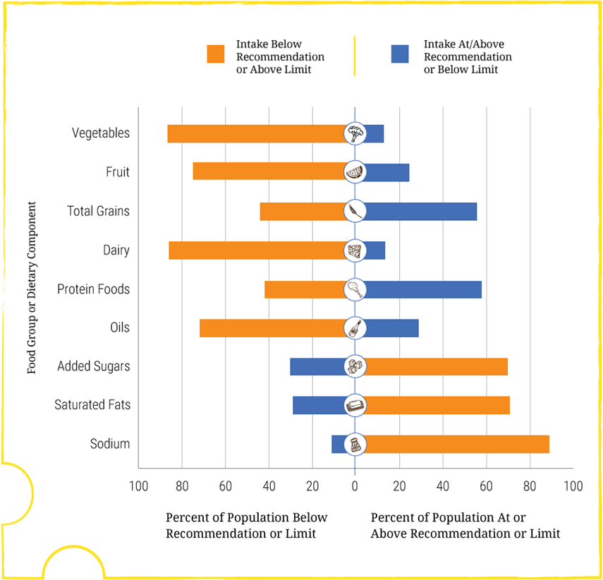
Current Eating Patterns in the United States
Percent of the U.S. Population Ages 1 Year and Older Who Are Below, At, or Above Each Dietary Goal or Limit (Figure 2-1)
Note: The center (0) line is the goal or limit. For most, those represented by the orange sections of the bars, shifting toward the center line will improve their eating pattern.
Data Source: What We Eat in America, NHANES 2007-2010 for average intakes by age-sex group. Healthy U.S.-Style Food Patterns, which vary based on age, sex, and activity level, for recommended intakes and limits.
Notes:
What we saw in the 2010 Dietary Guidelines continues today: The typical eating patterns currently consumed by many in the United States do not align with the Dietary Guidelines. This figure (Figure 2-1) provides a snapshot of current intakes compared to recommendations for the food groups (and oils); calories from added sugars and saturated fats; and sodium.
The center line is the goal or limit. The bar represents the percent of the U.S. population ages 1 year and older who are below, at, or above each dietary goal or limit.
In short, the orange bars represent the percent of Americans who are not meeting the recommendations and show areas with “room for improvement.”
When compared to the Healthy U.S.-Style Pattern:
About three-fourths of the population has an eating pattern that is low in vegetables, fruits, dairy, and oils.
More than half of the population is meeting or exceeding total grain and total protein foods recommendations, but, as discussed later in the chapter, are not meeting the recommendations for the subgroups within each of these food groups.
Most Americans exceed the recommendations for added sugars, saturated fats, and sodium.
In addition, the eating patterns of many are too high in calories. Calorie intake over time, in comparison to calorie needs, is best evaluated by measuring body weight status. The high percentage of the population that is overweight or obese suggests that many in the United States overconsume calories. As documented in the Introduction, Table I-1, more than two-thirds of all adults and nearly one-third of all children and youth in the United States are either overweight or obese.

Slide 29
A Closer Look at Current Intakes and
Recommended Shifts
Compares current intakes in the United States to recommendations and identifies potential shifts for:
  Food groups
  Other dietary components
Identifies nutrients of public health concern
Describes the importance of beverage
choices
Notes:
Chapter 2 includes a section providing detailed information for each food group and other component.
This section compares current intakes in the United States to recommendations and identifies potential shifts for
Food groups
Other dietary components
Identifies nutrients of public health concern
Describes the importance of beverage choices
Supplemental charts and figures (at the end of the presentation) provide a snapshot of current intakes and recommendations for each food group and subgroup.

Slide 30
Shifts to Align with Healthy Eating Patterns:
Examples
Increasing vegetables in mixed dishes while decreasing the amounts of refined grains or meats high in saturated fat and/or sodium.
Incorporating seafood in meals twice per week in place of meat, poultry, or eggs.
Using vegetable oil in place of solid fats when cooking, and using oil-based dressings and spreads on foods instead of those made from solid fats.
Choosing beverages with no added sugars, such as water.
Using the Nutrition Facts label to compare sodium content of foods and choosing the product with less sodium.
Notes:
For each food group and other component, Chapter 2 identifies suggested shifts that Americans can make in their food and beverage choices to move intakes closer to recommendations and limits. This slide shows a few examples of the shifts that are suggested.
Increasing vegetables in mixed dishes while decreasing the amounts of refined grains or meats high in saturated fat and/or sodium.
Incorporating seafood in meals twice per week in place of meat, poultry, or eggs.
Using vegetable oil in place of solid fats when cooking, and using oil-based dressings and spreads on foods instead of those made from solid fats.
Choosing beverages with no added sugars, such as water.
Using the Nutrition Facts label to compare sodium content of foods and choosing the product with less sodium.

Slide 31
Major Messages from Chapter 2
The U.S. population, across almost every age and sex group, consumes eating patterns that are:
  low in vegetables, fruits, whole grains, dairy, seafood, and oil
  high in refined grains, added sugars, saturated fats, sodium, and
  for some age-sex groups, high in the meats, poultry, and eggs subgroup.
Young children and older Americans generally are closer to the recommendations than are adolescents and young adults.
Notes:
In summary, the major messages provided in Chapter 2 are:
The U.S. population, across almost every age and sex group, consumes eating patterns that are
low in vegetables, fruits, whole grains, dairy, seafood, and oil
high in refined grains, added sugars, saturated fats, sodium, and
for some age-sex groups, high in the meats, poultry, and eggs subgroup.
Young children and older Americans generally are closer to the recommendations than are adolescents and young adults.

Slide 32
CHAPTER 3:
Everyone Has a Role in Supporting Healthy Eating Patterns
Notes:
In general, Americans are consuming too many calories, are not meeting food group and nutrient recommendations, and are not getting adequate physical activity. Collective action is needed to create a new paradigm in which healthy lifestyle choices at home, school, work, and in the community are easy, accessible, affordable, and normative. Everyone has a role in helping individuals shift their everyday food, beverage, and physical activity choices to align with the Dietary Guidelines.

Slide 33
Everyone Has a Role in Supporting Healthy Eating Patterns:
The Guidelines
Support healthy eating patterns for all. Everyone has a role in helping to create and support healthy eating patterns in multiple settings nationwide, from home to school to work to communities.
Notes:
This chapter focuses on the 5th Guideline:
5. “Support healthy eating patterns for all. Everyone has a role in helping to create and support healthy eating patterns in multiple settings nationwide, from home to school to work to communities.”

Slide 34
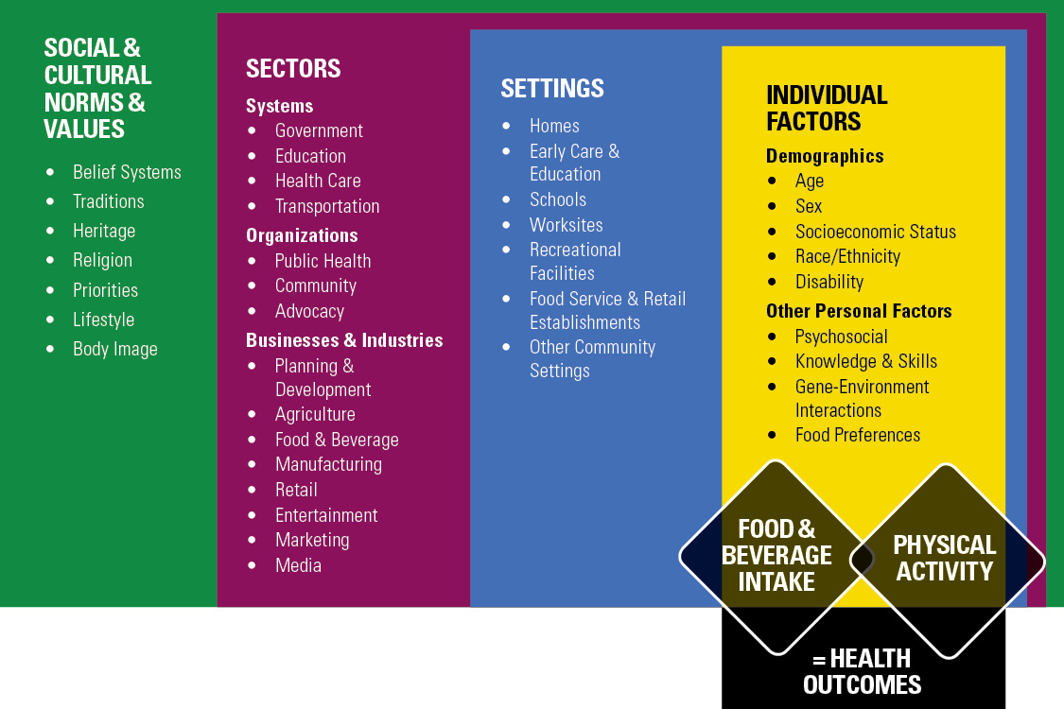
Creating and Supporting Healthy Choices
(Figure 3-1)
Data Source: Adapted from: (1) Centers for Disease Control and Prevention. Division of Nutrition, Physical Activity, and Obesity. National Center for Chronic Disease Prevention and Health Promotion. Addressing Obesity Disparities: Social Ecological Model. Available at: http://www.cdc.gov/obesity/health_equity/addressingtheissue.html. Accessed October 19, 2015. (2) Institute of Medicine. Preventing Childhood Obesity: Health in the Balance, Washington (DC): The National Academies Press; 2005, page 85. (3) Story M, Kaphingst KM, Robinson-O’Brien R, Glanz K. Creating healthy food and eating environments: Policy and environmental approaches. Annu Rev Public Health 2008; 29:253-272.
Notes:
As shown in the Social-Ecological Model, a multitude of choices, messages, individual resources, and other factors affect the food and physical activity choices an individual makes, and these decisions are rarely made in isolation. The following slides describes the various components in the Social-Ecological Model and how they play a role in influencing the decisions individuals make about foods and physical activity.

Slide 35
The Social Ecological Model
(Figure 3-1)
Data Source: Adapted from: (1) Centers for Disease Control and Prevention. Division of Nutrition, Physical Activity, and Obesity. National Center for Chronic Disease Prevention and Health Promotion. Addressing Obesity Disparities: Social Ecological Model. Available at: http://www.cdc.gov/obesity/health_equity/addressingtheissue.html. Accessed October 19, 2015. (2) Institute of Medicine. Preventing Childhood Obesity: Health in the Balance, Washington (DC): The National Academies Press; 2005, page 85. (3) Story M, Kaphingst KM, Robinson-O’Brien R, Glanz K. Creating healthy food and eating environments: Policy and environmental approaches. Annu Rev Public Health 2008; 29:253-272.
Notes:
As shown in the Social-Ecological Model, a multitude of choices, messages, individual resources, and other factors affect the food and physical activity choices an individual makes, and these decisions are rarely made in isolation. The following slides describes the various components in the Social-Ecological Model and how they play a role in influencing the decisions individuals make about foods and physical activity.

Slide 36
Meeting People Where They Are:
Contextual Factors and Healthy Eating Patterns
Food Access
Household Food Insecurity
Acculturation
Notes:
The scientific literature has described a number of specific circumstances that can limit an individual’s or family’s capacity to choose a healthy diet. These contextual factors—food access, household food insecurity, and acculturation—are particularly important for millions of individuals living in the United States. As appropriate, professionals can consider these critical factors when developing strategies and providing education to enhance interventions.
Food Access - Having access to healthy, safe, and affordable food choices is crucial for an individual to achieve a healthy eating pattern. Food access is influenced by diverse factors, including proximity to food retail outlets (e.g., distance to a store or the number of stores in an area), individual resources (e.g., income or personal transportation), and neighborhood-level resources (e.g., average income of the neighborhood and availability of public transportation). Race/ethnicity, socioeconomic status, geographic location, and the presence of a disability also may affect an individual’s ability to access foods to support healthy eating patterns.
Household Food Insecurity - In the United States, about 48 million individuals live in households that experience food insecurity, which occurs when access to nutritionally adequate and safe food is limited or uncertain. Food insecurity can be temporary or persist over time. Living with food insecurity challenges a household’s ability to obtain food and make healthy choices and can exacerbate stress and chronic disease risk. Government and nongovernment nutrition assistance programs play an essential role in providing food and educational resources to help participants make healthy food choices within their budget.
Acculturation - Individuals who come to this country may adopt the attitudes, values, customs, beliefs, and behaviors of a new culture as well as its dietary habits. Healthy eating patterns are designed to be flexible in order to accommodate traditional and cultural foods. Individuals are encouraged to retain the healthy aspects of their eating and physical activity patterns and avoid adopting behaviors that are less healthy.

Slide 37

Strategies To Align Settings With the 2015-2020 Dietary Guidelines for Americans (Figure 3-3)
Notes:
To shift from current eating patterns to those that align with the Dietary Guidelines, collective action across all segments of society is needed. As previously described, these actions must involve a broad range of sectors, occur across a variety of settings, and address the needs of individuals, families, and communities. These actions include identifying and addressing successful approaches for change; improving knowledge of what constitutes healthy eating and physical activity patterns; enhancing access to adequate amounts of healthy, safe, and affordable food choices; and promoting change in social and cultural norms and values to embrace, support, and maintain healthy eating and physical activity behaviors.
For example, at home, individuals and families can try out small changes to find what works for them, like adding more veggies to favorite dishes, planning meals and cooking at home, and incorporating physical activity into time with family or friends.
Schools can continue to offer healthy food choices in cafeterias and vending machines, provide nutrition education programs and school gardens, and encourage parents and caregivers to promote healthy changes at home.
Workplaces can offer healthy food options in the cafeteria, vending machines, and at staff meetings or functions; provide health and wellness programs and nutrition counseling; and encourage walking meetings or activity breaks.
Communities can increase access to affordable, healthy food choices through community gardens, farmers’ markets, shelters, and food banks and create walkable communities by maintaining safe public spaces.
Food retail outlets can inform consumers about making healthy changes and provide healthy food choices.

Slide 38
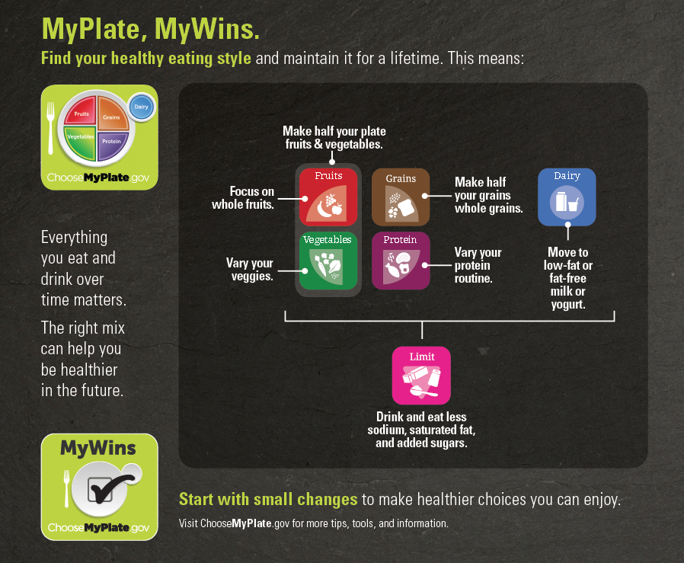
Implementing the Guidelines Through MyPlate
(Figure 3-2)
Notes:
The Dietary Guidelines is developed and written for a professional audience. Therefore, its translation into actionable consumer messages and resources is crucial to help individuals, families, and communities achieve healthy eating patterns. MyPlate is one such example (Figure 3-2). MyPlate is used by professionals across multiple sectors to help individuals become more aware of and educated about making healthy food and beverage choices over time. Created to be used in various settings and to be adaptable to the needs of specific population groups, the MyPlate symbol and its supporting consumer resources at ChooseMyPlate.gov bring together the key elements of healthy eating patterns, translating the Dietary Guidelines into key consumer messages that are used in educational materials and tools for the public.

Slide 39
Major Messages from Chapter 3
Concerted efforts among all segments of society are needed to support healthy lifestyle choices that align with the Dietary Guidelines.
Professionals have an important role in leading
disease-prevention efforts.
Collaborative efforts can have a meaningful impact on the health of current and future generations.
Notes:
Concerted efforts among professionals within communities, businesses and industries, organizations, governments, and other segments of society are needed to support individuals and families in making lifestyle choices that align with the Dietary Guidelines. Professionals have an important role in leading disease-prevention efforts within their organizations and communities to make healthy eating and regular physical activity an organizational and societal norm. Changes at multiple levels of the Social-Ecological Model are needed, and these changes, in combination and over time, can have a meaningful impact on the health of current and future generations.

Slide 40
SUPPLEMENTAL INFORMATION:
Charts and Figures

Slide 41
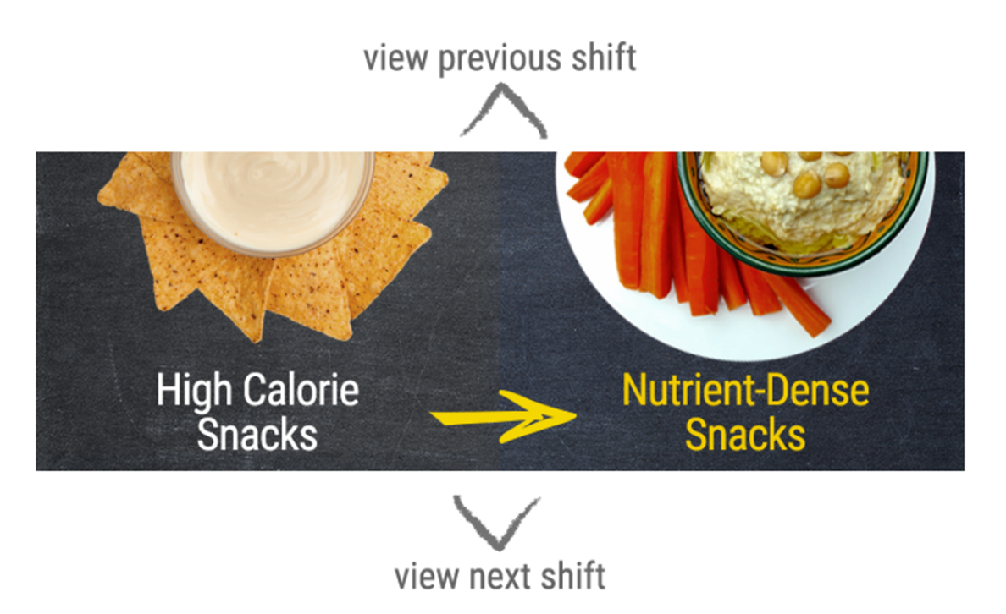
Interactive Figures
New in the 2015-2020 Dietary Guidelines for Americans
Notes:
The 2015-2020 Dietary Guidelines for Americans includes a number of new interactive figures that help to further illustrate key concepts specific to implementing the Dietary Guidelines. These figures feature topics like the one shown on this slide (Figure 2-2) suggesting shifts that can help people adopt healthy eating patterns.
Other interactive figures include:
The Dietary Guidelines at a Glance (Figure ES-1)
Science, Policy, Implementation: Developing the Dietary Guidelines for Americans (Figure I-3)
Cup- and Ounce-Equivalents (Figure 1-1)
Hidden Components in Eating Patterns (Figure 1-3)
Empower People to Make Healthy Shifts (Figure 2-2)
Typical Versus Nutrient-Dense Foods and Beverages (Figure 2-8)
A Social-Ecological Model for Food and Physical Activity Decisions (Figure 3-1)
Strategies to Align Settings With the 2015-2020 Dietary Guidelines (Figure 3-3)

Slide 42
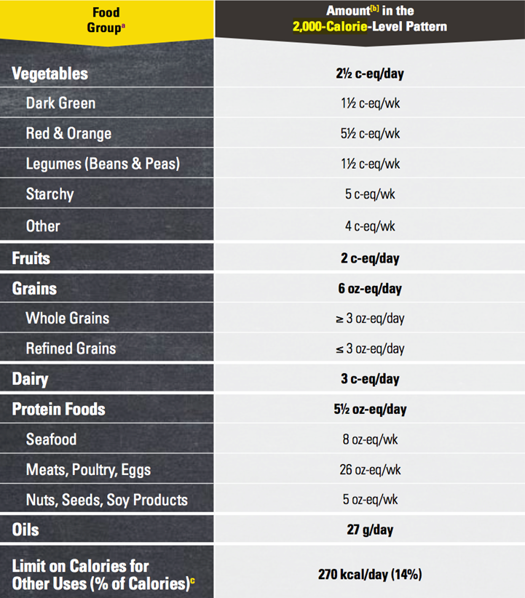
Healthy Eating Patterns:
Healthy U.S.-Style Eating Pattern at the 2,000-Calorie Level
Notes:
There are many ways to consume a healthy eating pattern, and the evidence to support multiple approaches has expanded over time.
Throughout the 2015-2020 Dietary Guidelines, the Healthy U.S.-Style Eating Pattern is used to illustrate the specific amounts and limits for food groups and other dietary components that make up healthy eating patterns. The Healthy U.S.-Style Eating Pattern at the 2000-calorie level is illustrated here.
Two additional healthy eating patterns—the Healthy Mediterranean-Style Eating Pattern and the Healthy Vegetarian Eating Pattern—are provided as examples to reflect other styles of eating.
The Healthy Mediterranean-Style Eating Pattern and Healthy Vegetarian Eating Pattern were developed by modifying the Healthy U.S.-Style Eating Pattern. Similar to the Healthy U.S.-Style Eating Pattern, these patterns were designed to consider the types and proportions of foods Americans typically consume, but in nutrient-dense forms and appropriate amounts, which result in eating patterns that are attainable and relevant in the U.S. population.
Appendices to the Guidelines provide detailed information about all three example eating patterns at 12 calorie levels—from 1000 to 3200 calories.
Additionally, healthy eating patterns can be flexible with respect to the intake of carbohydrate, protein, and fat within the context of the AMDR

Slide 43
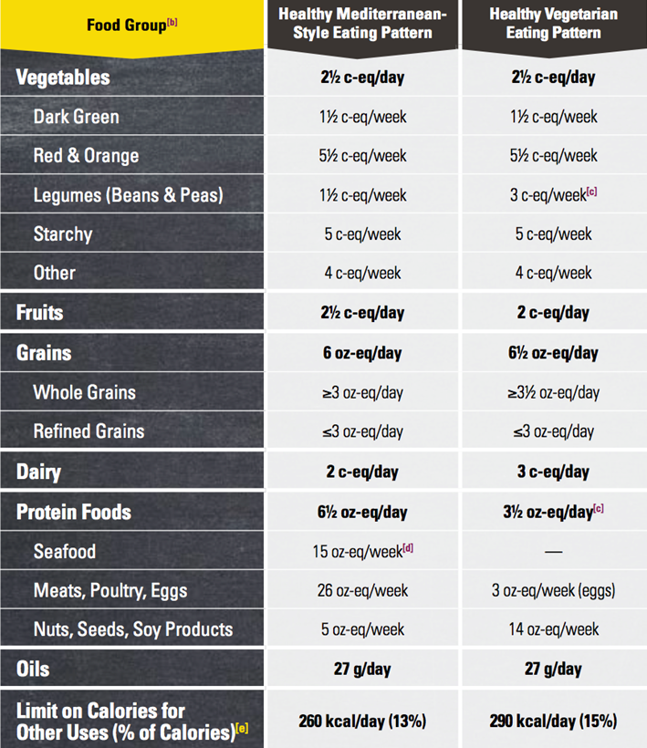
Healthy Eating Patterns:
Healthy Mediterranean-Style and Healthy Vegetarian Eating Patterns at the
2,000-Calorie Level
Notes:
There are many ways to consume a healthy eating pattern, and the evidence to support multiple approaches has expanded over time.
Throughout the 2015-2020 Dietary Guidelines, the Healthy U.S.-Style Eating Pattern is used to illustrate the specific amounts and limits for food groups and other dietary components that make up healthy eating patterns. Two additional healthy eating patterns—the Healthy Mediterranean-Style Eating Pattern and the Healthy Vegetarian Eating Pattern—are provided as examples to reflect other styles of eating.
The Healthy Mediterranean-Style and Healthy Vegetarian Eating Patterns at the 2000-calorie level are illustrated here.
The Healthy Mediterranean-Style Eating Pattern and Healthy Vegetarian Eating Pattern were developed by modifying the Healthy U.S.-Style Eating Pattern. Similar to the Healthy U.S.-Style Eating Pattern, these patterns were designed to consider the types and proportions of foods Americans typically consume, but in nutrient-dense forms and appropriate amounts, which result in eating patterns that are attainable and relevant in the U.S. population.
Appendices to the Guidelines provide detailed information about all three example eating patterns at 12 calorie levels—from 1000 to 3200 calories.
Additionally, healthy eating patterns can be flexible with respect to the intake of carbohydrate, protein, and fat within the context of the AMDR

Slide 44
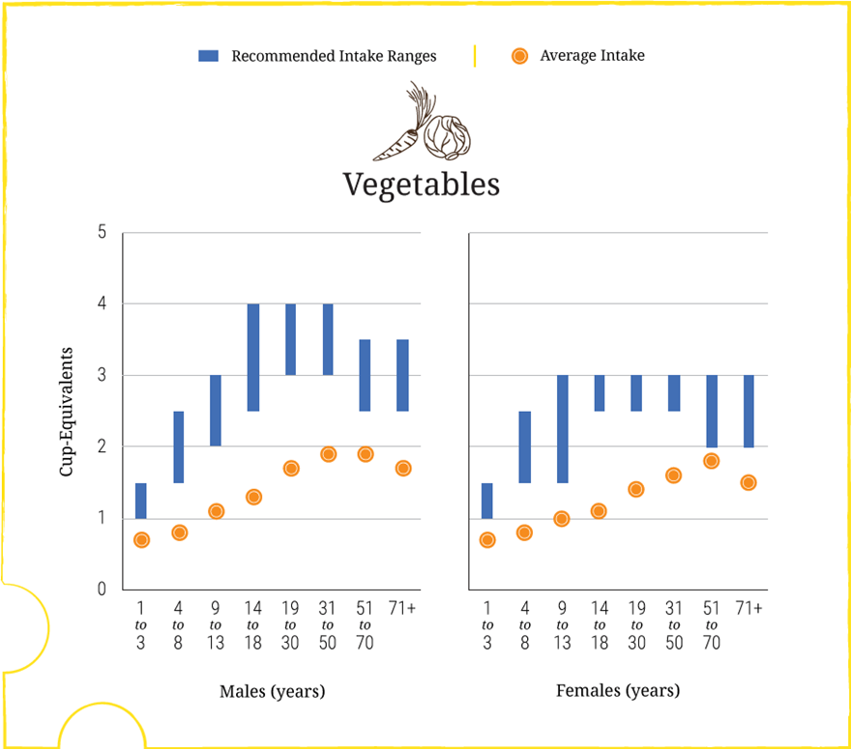
Vegetables: Intakes and Recommendations
Average Daily Intakes by Age-Sex Groups, Compared to Ranges of Recommended Intake (from Figure 2-3)
Data Sources:
What We Eat in America, NHANES 2007-2010 for average intakes by age-sex group. Healthy U.S.-Style Food Patterns, which vary based on age, sex, and activity level, for recommended intake ranges.
Notes:
Chapter 2 provides a number of figures to highlight current intakes compared to recommendations. Figure 2-3 includes a comparison of intakes to recommendations for each food group across age-sex groups.
This section of the figure is for the vegetable group.
The blue bar represents the range of recommended intake for vegetables. The orange dot indicates current intakes of vegetables.
This figure shows the low average intakes of vegetables across age-sex groups in comparison to recommended intake levels. Vegetable consumption relative to recommendations is lowest among boys ages 9 to 13 years and girls ages 14 to 18 years. Vegetable intakes relative to recommendations are slightly higher during the adult years, but intakes are still below recommendations.
The main shift message for vegetables is to: Shift to Consume More Vegetables

Slide 45
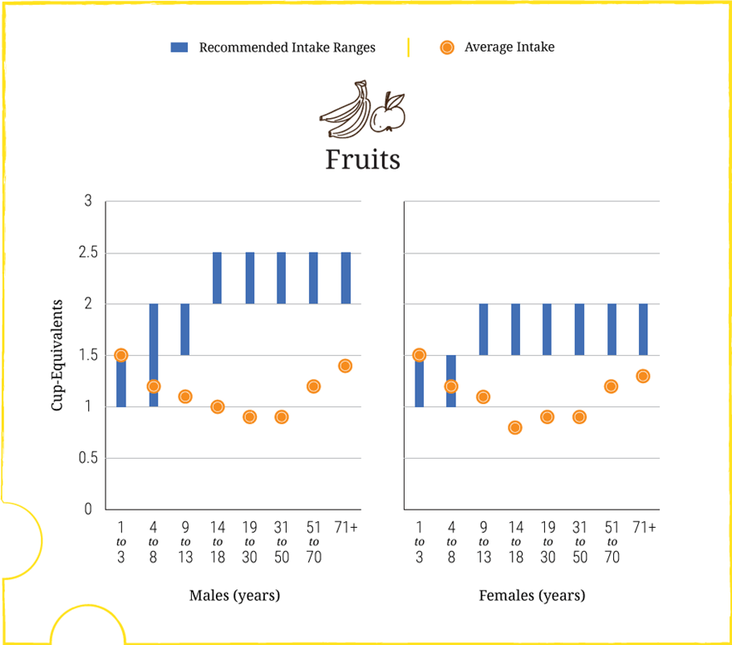
Fruits: Intakes and Recommendations
Average Daily Intakes by Age-Sex Groups, Compared to Ranges of Recommended Intake (from Figure 2-3)
Data Sources:
What We Eat in America, NHANES 2007-2010 for average intakes by age-sex group. Healthy U.S.-Style Food Patterns, which vary based on age, sex, and activity level, for recommended intake ranges.
Notes:
Chapter 2 provides a number of figures to highlight current intakes compared to recommendations. Figure 2-3 includes a comparison of intakes to recommendations for each food group across age-sex groups.
This section of the figure is for the fruit group.
The blue bar represents the range of recommended intake for fruit. The orange dot indicates current intakes of fruit.
This figure shows that average intake of fruits is below recommendations for almost all age-sex groups. Children ages 1 to 8 years differ from the rest of the population in that many do meet recommended intakes for total fruit. Average intakes of fruits, including 100% juice, are lowest among girls ages 14 to 18 years and adults ages 19 to 50 years. Older women (ages 51 years and older) and young children consume fruits in amounts close to or meeting minimum recommended intakes.
The main shift message for fruits is to: Shift to Consume More Fruits

Slide 46
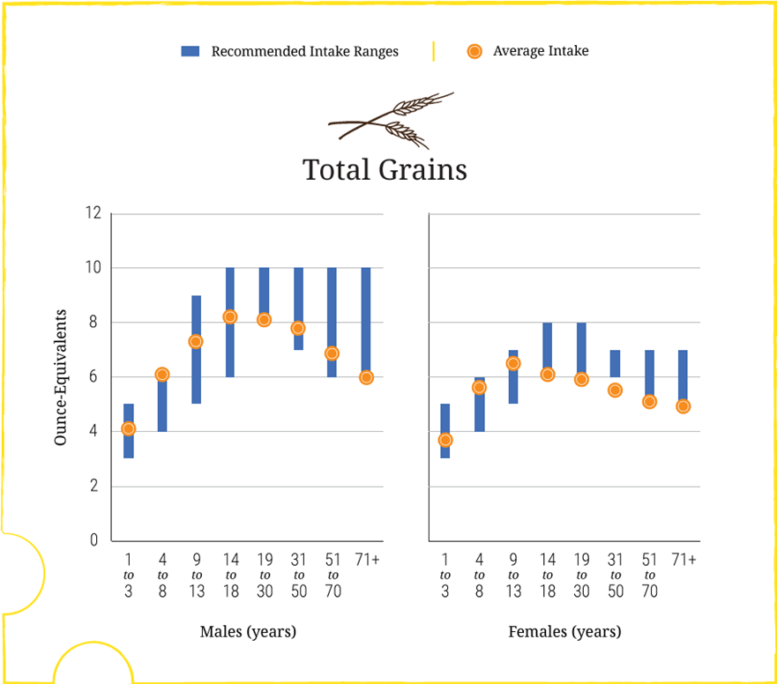
Total Grains: Intakes and Recommendations
Average Daily Intakes by Age-Sex Groups, Compared to Ranges of Recommended Intake (from Figure 2-3)
Data Sources:
What We Eat in America, NHANES 2007-2010 for average intakes by age-sex group. Healthy U.S.-Style Food Patterns, which vary based on age, sex, and activity level, for recommended intake ranges.
Notes:
Chapter 2 provides a number of figures to highlight current intakes compared to recommendations. Figure 2-3 includes a comparison of intakes to recommendations for each food group across age-sex groups.
This section of the figure is for the grains group (whole and refined).
The blue bar represents the range of recommended intake for total grains. The orange dot indicates current intakes of total grains.
This figure shows that intakes of total grains are close to the target amounts for all age-sex groups, but as shown in Figure 2-5 (slide 39), intakes do not meet the recommendations for whole grains and exceed limits for refined grains. Average intakes of whole grains are far below recommended levels across all age-sex groups, and average intakes of refined grains are well above recommended limits for most age-sex groups.
The main shift message for grains is to: Shift to Make Half of All Grains Consumed be Whole Grains

Slide 47
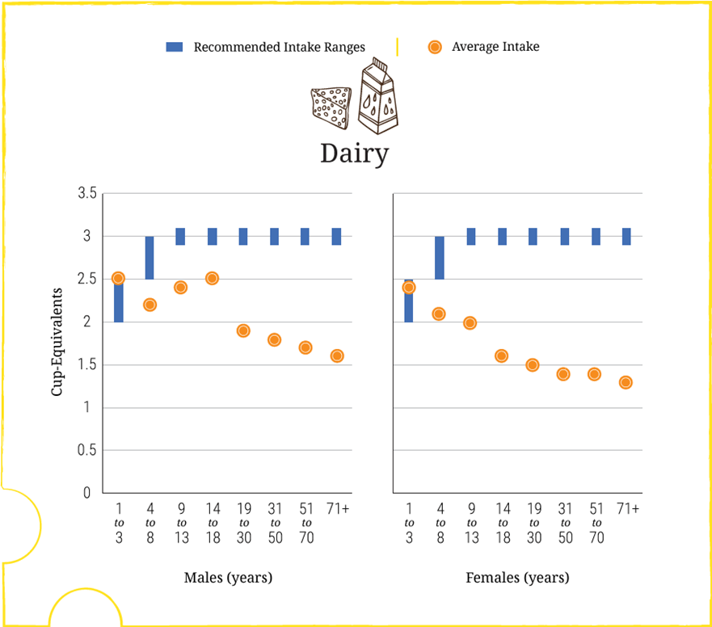
Dairy: Intakes and Recommendations
Average Daily Intakes by Age-Sex Groups, Compared to Ranges of Recommended Intake (from Figure 2-3)
Data Sources:
What We Eat in America, NHANES 2007-2010 for average intakes by age-sex group. Healthy U.S.-Style Food Patterns, which vary based on age, sex, and activity level, for recommended intake ranges.
Notes:
Chapter 2 provides a number of figures to highlight current intakes compared to recommendations. Figure 2-3 includes a comparison of intakes to recommendations for each food group across age-sex groups.
This section of the figure is for the dairy group.
The blue bar represents the range of recommended intake for the dairy group. The orange dot indicates current intakes of dairy foods.
This figure shows that average intakes of dairy for most age-sex groups are far below recommendations of the Healthy U.S.-Style Pattern. Average dairy intake for most young children ages 1 to 3 years meets recommended amounts, but all other age groups have average intakes that are below recommendations. An age-related decline in dairy intake begins in childhood, and intakes persist at low levels for adults of all ages.
Fluid milk (51%) and cheese (45%) comprise most of dairy consumption. Yogurt (2.6%) and fortified soy beverages (commonly known as “soymilk”) (1.5%) make up the rest of dairy intake. About three-fourths of all milk is consumed as a beverage or on cereal, but cheese is most commonly consumed as part of mixed dishes, such as burgers, sandwiches, tacos, pizza, and pasta dishes.
The main shift message for dairy is to: Shift to Consume More Dairy Products, in Nutrient-Dense Forms

Slide 48
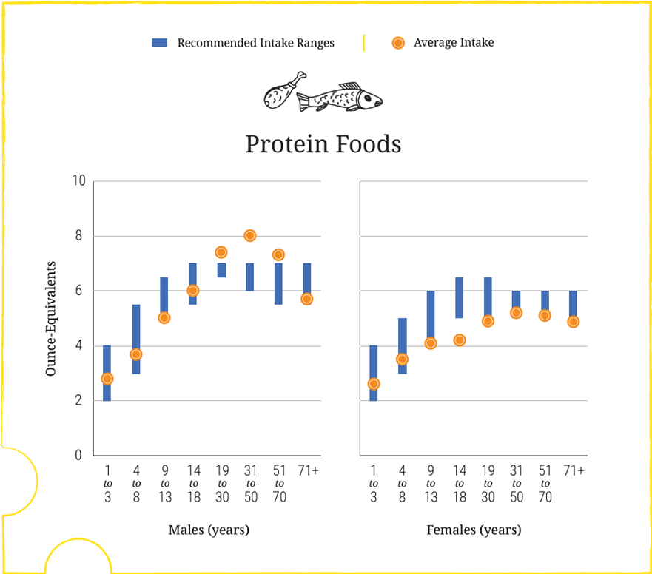
Protein Foods: Intakes and Recommendations
Average Daily Intakes by Age-Sex Groups, Compared to Ranges of Recommended Intake (from Figure 2-3)
Data Sources:
What We Eat in America, NHANES 2007-2010 for average intakes by age-sex group. Healthy U.S.-Style Food Patterns, which vary based on age, sex, and activity level, for recommended intake ranges.
Notes:
Chapter 2 provides a number of figures to highlight current intakes compared to recommendations. Figure 2-3 includes a comparison of intakes to recommendations for each food group across age-sex groups.
This section of the figure is for the protein foods group.
The blue bar represents the range of recommended intake for the protein foods group. The orange dot indicates current intakes of protein foods.
This figure shows that overall, average intakes of protein foods are close to amounts recommended for all age-sex groups. However, Figure 2-6 (slides 40 to 42) shows that the average intakes of protein foods subgroups vary in comparison to the range of intake recommendations.
The main shift message for protein foods is to: Shift to Increase Variety in Protein Foods Choices and to Make More Nutrient-Dense Choices

Slide 49
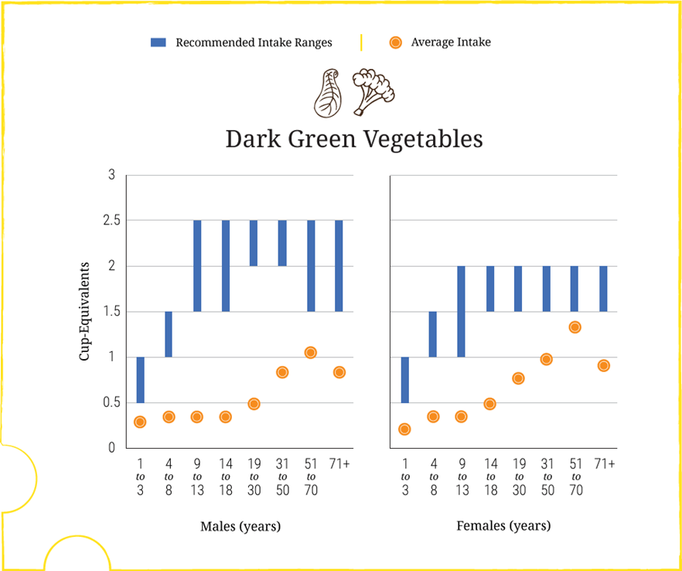
Dark Green Vegetables: Intakes and Recommendations
Average Weekly Intakes by Age-Sex Groups, Compared to Ranges of Recommended Intake (from Figure 2-4)
Data Sources:
What We Eat in America, NHANES 2007-2010 for average intakes by age-sex group. Healthy U.S.-Style Food Patterns, which vary based on age, sex, and activity level, for recommended intake ranges.
Notes:
Chapter 2 provides a number of figures to highlight current intakes compared to recommendations. Figure 2-4 includes a comparison of weekly intakes to recommendations for each vegetable subgroup across age-sex groups. With few exceptions, the U.S. population does not meet intake recommendations for any of the vegetable subgroups.
This section of the figure is for dark green vegetables.
The blue bar represents the range of recommended weekly intake for dark green vegetables. The orange dot indicates current weekly intakes of dark green vegetables for each age-sex group.
Dark green vegetables include Broccoli, spinach, leafy salad greens (including romaine lettuce), collards, bok choy, kale, turnip greens, mustard greens, green herbs (parsley, cilantro).
Examples of Vegetables in Each Vegetable Subgroup
Dark-green vegetables: Broccoli, spinach, leafy salad greens (including romaine lettuce), collards, bok choy, kale, turnip greens, mustard greens, green herbs (parsley, cilantro)
Red and orange vegetables: Tomatoes, carrots, tomato juice, sweet potatoes, red peppers (hot and sweet), winter squash, pumpkin
Legumes (beans and peas): Pinto, white, kidney, and black beans; lentils; chickpeas; limas (mature, dried); split peas; edamame (green soybeans)
Starchy vegetables: Potatoes, corn, green peas, limas (green, immature), plaintains, cassava
Other vegetables: Lettuce (iceberg), onions, green beans, cucumbers, celery, green peppers, cabbage, mushrooms, avocado, summer squash (includes zucchini), cauliflower, eggplant, garlic, bean sprouts, olives, asparagus, peapods (snowpeas), beets

Slide 50
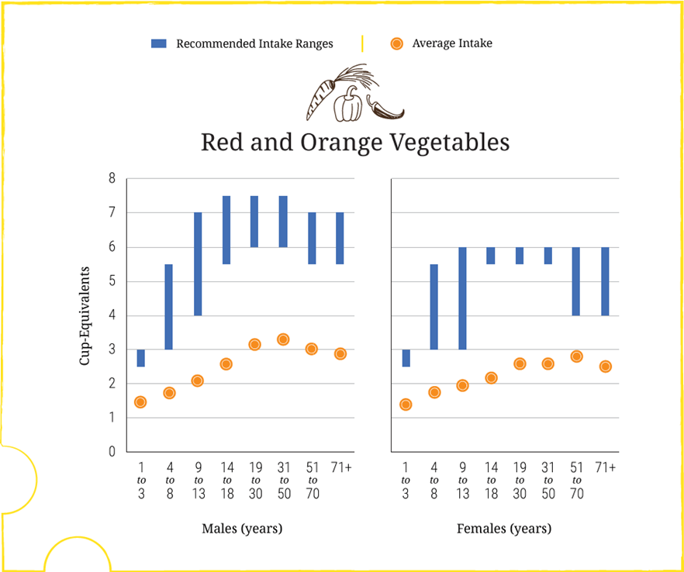
Red and Orange Vegetables: Intakes and Recommendations
Average Weekly Intakes by Age-Sex Groups, Compared to Ranges of Recommended Intake (from Figure 2-4)
Data Sources:
What We Eat in America, NHANES 2007-2010 for average intakes by age-sex group. Healthy U.S.-Style Food Patterns, which vary based on age, sex, and activity level, for recommended intake ranges.
Notes:
Chapter 2 provides a number of figures to highlight current intakes compared to recommendations. Figure 2-4 includes a comparison of weekly intakes to recommendations for each vegetable subgroup across age-sex groups. With few exceptions, the U.S. population does not meet intake recommendations for any of the vegetable subgroups.
This section of the figure is for red and orange vegetables.
The blue bar represents the range of recommended weekly intake for red and orange vegetables. The orange dot indicates current weekly intakes of red and orange vegetables for each age-sex group.
Red and orange vegetables include tomatoes, carrots, tomato juice, sweet potatoes, red peppers (hot and sweet), winter squash, pumpkin.
Examples of Vegetables in Each Vegetable Subgroup
Dark-green vegetables: Broccoli, spinach, leafy salad greens (including romaine lettuce), collards, bok choy, kale, turnip greens, mustard greens, green herbs (parsley, cilantro)
Red and orange vegetables: Tomatoes, carrots, tomato juice, sweet potatoes, red peppers (hot and sweet), winter squash, pumpkin
Legumes (beans and peas): Pinto, white, kidney, and black beans; lentils; chickpeas; limas (mature, dried); split peas; edamame (green soybeans)
Starchy vegetables: Potatoes, corn, green peas, limas (green, immature), plaintains, cassava
Other vegetables: Lettuce (iceberg), onions, green beans, cucumbers, celery, green peppers, cabbage, mushrooms, avocado, summer squash (includes zucchini), cauliflower, eggplant, garlic, bean sprouts, olives, asparagus, peapods (snowpeas), beets

Slide 51
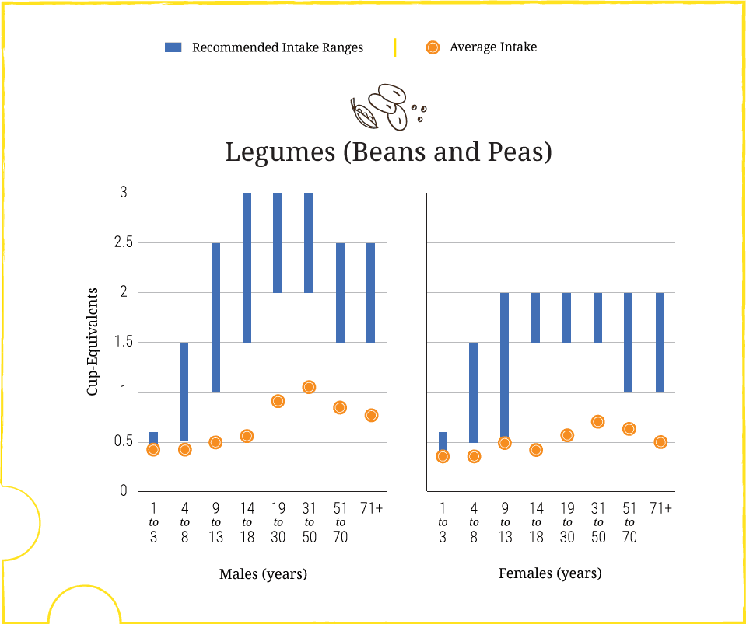
Legumes: Intakes and Recommendations
Average Weekly Intakes by Age-Sex Groups, Compared to Ranges of Recommended Intake (from Figure 2-4)
Data Sources:
What We Eat in America, NHANES 2007-2010 for average intakes by age-sex group. Healthy U.S.-Style Food Patterns, which vary based on age, sex, and activity level, for recommended intake ranges.
Notes:
Chapter 2 provides a number of figures to highlight current intakes compared to recommendations. Figure 2-4 includes a comparison of weekly intakes to recommendations for each vegetable subgroup across age-sex groups. With few exceptions, the U.S. population does not meet intake recommendations for any of the vegetable subgroups.
This section of the figure is for legumes (beans and peas).
The blue bar represents the range of recommended weekly intake for legumes. The orange dot indicates current weekly intakes of legumes for each age-sex group.
Legumes include pinto, white, kidney, and black beans; lentils; chickpeas; limas (mature, dried); split peas; edamame (green soybeans).
While legumes are a vegetables subgroup, they also may be considered as part of the protein foods group (see the About Legumes (Beans and Peas) call-out box in Chapter 1).
Examples of Vegetables in Each Vegetable Subgroup
Dark-green vegetables: Broccoli, spinach, leafy salad greens (including romaine lettuce), collards, bok choy, kale, turnip greens, mustard greens, green herbs (parsley, cilantro)
Red and orange vegetables: Tomatoes, carrots, tomato juice, sweet potatoes, red peppers (hot and sweet), winter squash, pumpkin
Legumes (beans and peas): Pinto, white, kidney, and black beans; lentils; chickpeas; limas (mature, dried); split peas; edamame (green soybeans)
Starchy vegetables: Potatoes, corn, green peas, limas (green, immature), plaintains, cassava
Other vegetables: Lettuce (iceberg), onions, green beans, cucumbers, celery, green peppers, cabbage, mushrooms, avocado, summer squash (includes zucchini), cauliflower, eggplant, garlic, bean sprouts, olives, asparagus, peapods (snowpeas), beets

Slide 52
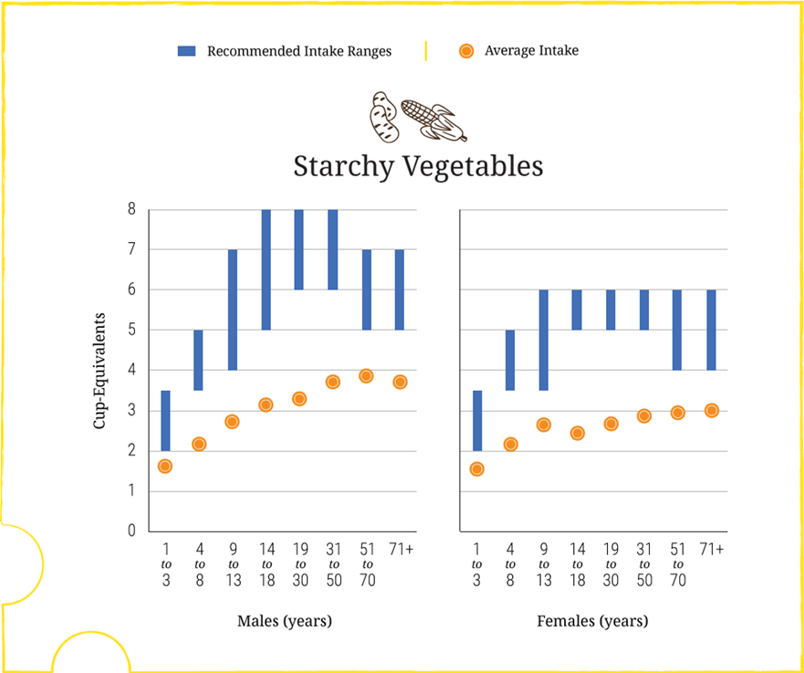
Starchy Vegetables: Intakes and Recommendations
Average Weekly Intakes by Age-Sex Groups, Compared to Ranges of Recommended Intake (from Figure 2-4)
Data Sources:
What We Eat in America, NHANES 2007-2010 for average intakes by age-sex group. Healthy U.S.-Style Food Patterns, which vary based on age, sex, and activity level, for recommended intake ranges.
Notes:
Chapter 2 provides a number of figures to highlight current intakes compared to recommendations. Figure 2-4 includes a comparison of weekly intakes to recommendations for each vegetable subgroup across age-sex groups. With few exceptions, the U.S. population does not meet intake recommendations for any of the vegetable subgroups.
This section of the figure is for starchy vegetables.
The blue bar represents the range of recommended weekly intake for starchy vegetables. The orange dot indicates current weekly intakes of starchy vegetables for each age-sex group.
Starchy vegetables include potatoes, corn, green peas, limas (green, immature), plaintains, cassava
Examples of Vegetables in Each Vegetable Subgroup
Dark-green vegetables: Broccoli, spinach, leafy salad greens (including romaine lettuce), collards, bok choy, kale, turnip greens, mustard greens, green herbs (parsley, cilantro)
Red and orange vegetables: Tomatoes, carrots, tomato juice, sweet potatoes, red peppers (hot and sweet), winter squash, pumpkin
Legumes (beans and peas): Pinto, white, kidney, and black beans; lentils; chickpeas; limas (mature, dried); split peas; edamame (green soybeans)
Starchy vegetables: Potatoes, corn, green peas, limas (green, immature), plaintains, cassava
Other vegetables: Lettuce (iceberg), onions, green beans, cucumbers, celery, green peppers, cabbage, mushrooms, avocado, summer squash (includes zucchini), cauliflower, eggplant, garlic, bean sprouts, olives, asparagus, peapods (snowpeas), beets

Slide 53
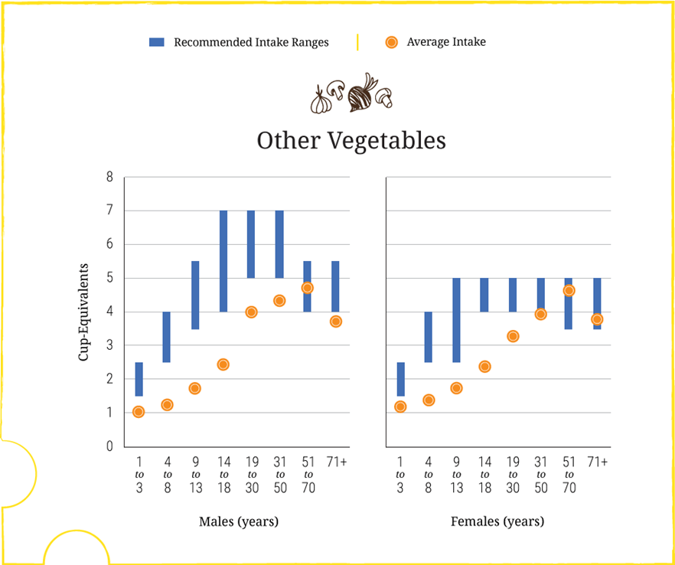
Other Vegetables: Intakes and Recommendations
Average Weekly Intakes by Age-Sex Groups, Compared to Ranges of Recommended Intake (from Figure 2-4)
Data Sources:
What We Eat in America, NHANES 2007-2010 for average intakes by age-sex group. Healthy U.S.-Style Food Patterns, which vary based on age, sex, and activity level, for recommended intake ranges.
Notes:
Chapter 2 provides a number of figures to highlight current intakes compared to recommendations. Figure 2-4 includes a comparison of weekly intakes to recommendations for each vegetable subgroup across age-sex groups. With few exceptions, the U.S. population does not meet intake recommendations for any of the vegetable subgroups.
This section of the figure is for other vegetables.
The blue bar represents the range of recommended weekly intake for other vegetables. The orange dot indicates current weekly intakes of other vegetables for each age-sex group.
Other vegetables include lettuce (iceberg), onions, green beans, cucumbers, celery, green peppers, cabbage, mushrooms, avocado, summer squash (includes zucchini), cauliflower, eggplant, garlic, bean sprouts, olives, asparagus, peapods (snowpeas), beets
Examples of Vegetables in Each Vegetable Subgroup
Dark-green vegetables: Broccoli, spinach, leafy salad greens (including romaine lettuce), collards, bok choy, kale, turnip greens, mustard greens, green herbs (parsley, cilantro)
Red and orange vegetables: Tomatoes, carrots, tomato juice, sweet potatoes, red peppers (hot and sweet), winter squash, pumpkin
Legumes (beans and peas): Pinto, white, kidney, and black beans; lentils; chickpeas; limas (mature, dried); split peas; edamame (green soybeans)
Starchy vegetables: Potatoes, corn, green peas, limas (green, immature), plaintains, cassava
Other vegetables: Lettuce (iceberg), onions, green beans, cucumbers, celery, green peppers, cabbage, mushrooms, avocado, summer squash (includes zucchini), cauliflower, eggplant, garlic, bean sprouts, olives, asparagus, peapods (snowpeas), beets

Slide 54
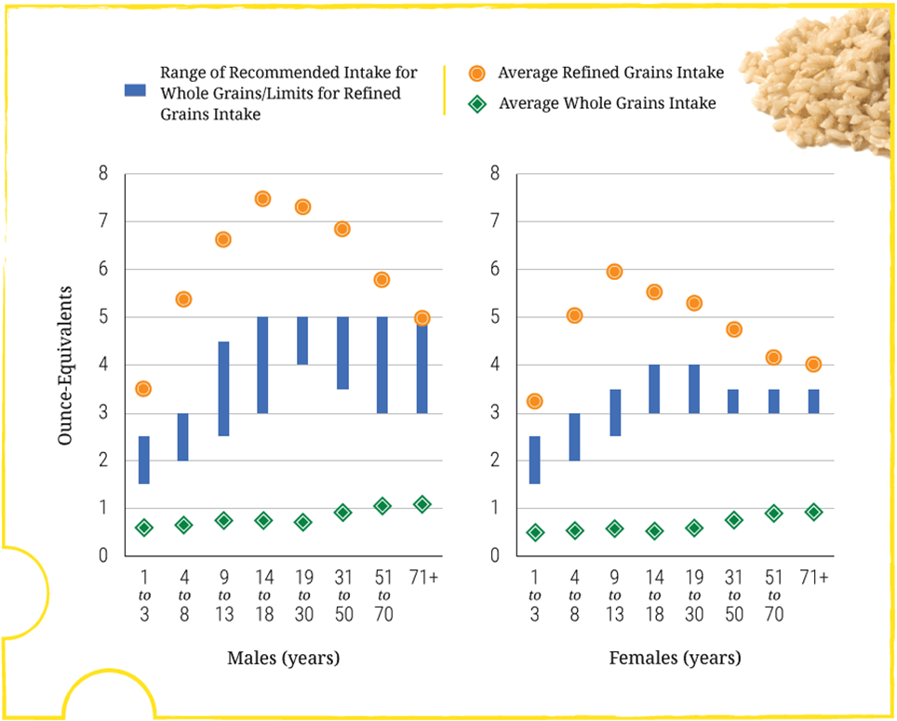
Whole and Refined Grains: Intakes and Recommendations
Average Intakes by Age-Sex Groups, Compared to Ranges of Recommended Daily Intake for Whole Grains and Limits for Refined Grains (Figure 2-5)
Note: Recommended daily intake of whole grains is to be at least half of total grain consumption, and the limit for refined grains is to be no more than half of total grain consumption. The blue vertical bars on this graph represent one half of the total grain recommendations for each age-sex group, and therefore indicate recommendations for the minimum amounts to consume of whole grains or maximum amounts of refined grains. To meet recommendations, whole grain intake should be within or above the blue bars and refined grain intake within or below the bars.
Data Sources: What We Eat in America, NHANES 2007-2010 for average intakes by age-sex group. Healthy U.S.-Style Food Patterns, which vary based on age, sex, and activity level, for recommended intake ranges.
Notes:
Chapter 2 provides a number of figures to highlight current intakes compared to recommendations. Figure 2-5 compares intakes to recommendations for whole and refined grains across age-sex groups.
The blue bar represents the range of recommended intake for whole grains and limits for refined grains. [Recommendations for whole grains and limits for refined grains are the same—both equal to one-half of the total grain recommendation—for each age/sex group.]
The orange dot indicates current intakes of refined grains, and the green diamonds shows current intake of whole grains.
Ideally, the orange dots and green diamonds would fall within the blue bars.
This graph shows intakes do not meet the recommendations for whole grains and exceed limits for refined grains. Average intakes of whole grains are far below recommended levels across all age-sex groups, and average intakes of refined grains are well above recommended limits for most age-sex groups.
Examples of commonly consumed whole-grain foods are whole-wheat breads, rolls, bagels, and crackers; oatmeal; whole-grain ready-to-eat cereals (e.g., shredded wheat, oat rings); popcorn; brown rice; and whole-grain pasta.
Examples of refined grain foods are white bread, rolls, bagels, and crackers; pasta; pizza crust; grain-based desserts; refined grain ready-to-eat cereals (e.g., corn flakes, crispy rice cereal); corn and wheat tortillas; white rice; and cornbread. As noted in Chapter 1, most refined grain foods in the United States are made from enriched grains.

Slide 55
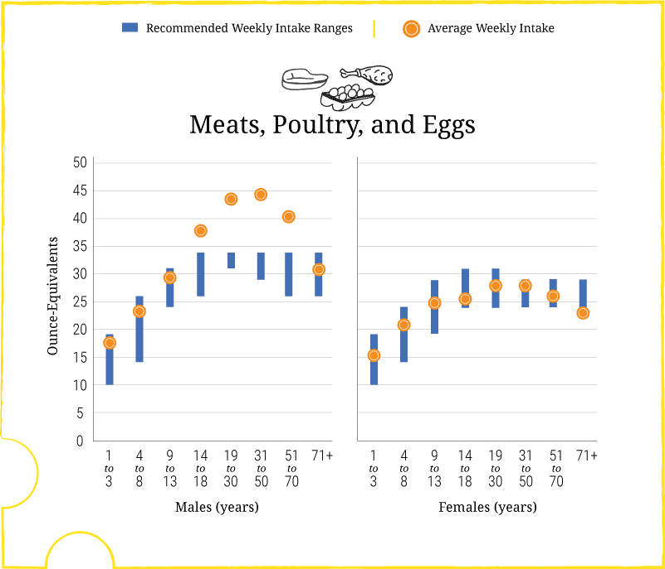
Meat, Poultry, and Eggs: Intakes and Recommendations
Average Weekly Intakes by Age-Sex Groups, Compared to Ranges of Recommended Intake (from Figure 2-6)
Data Sources:
What We Eat in America, NHANES 2007-2010 for average intakes by age-sex group. Healthy U.S.-Style Food Patterns, which vary based on age, sex, and activity level, for recommended intake ranges.
Notes:
Chapter 2 provides a number of figures to highlight current intakes compared to recommendations. Figure 2-6 includes a comparison of weekly intakes to recommendations for each protein foods subgroup across age-sex groups.
This section of the figure is for meat, poultry, and eggs.
The blue bar represents the range of recommended weekly intake for meat, poultry, and eggs. The orange dot indicates current weekly intakes of meat, poultry, and eggs for each age-sex group.
Overall, average intakes of protein foods are close to amounts recommended for all age-sex groups (Figure 2-3, slide 33). However, this figure shows that the average intakes of protein foods subgroups vary in comparison to the range of intake recommendations.
Average intakes of meats, poultry, and eggs are high for teen boys and adult men.

Slide 56
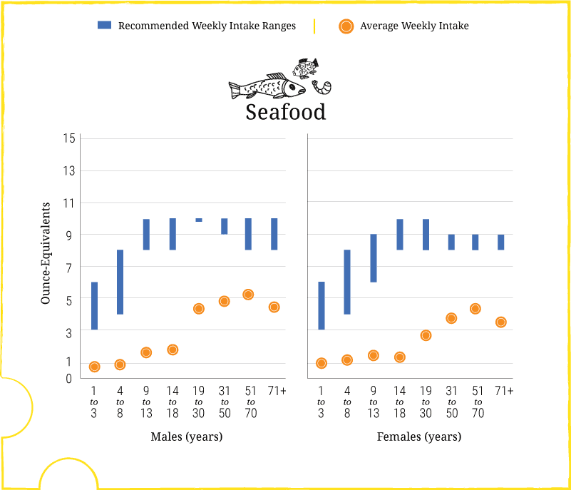
Seafood: Intakes and Recommendations
Average Weekly Intakes by Age-Sex Groups, Compared to Ranges of Recommended Intake (from Figure 2-6)
Data Sources:
What We Eat in America, NHANES 2007-2010 for average intakes by age-sex group. Healthy U.S.-Style Food Patterns, which vary based on age, sex, and activity level, for recommended intake ranges.
Notes:
Chapter 2 provides a number of figures to highlight current intakes compared to recommendations. Figure 2-6 includes a comparison of weekly intakes to recommendations for each protein foods subgroup across age-sex groups.
This section of the figure is for seafood.
The blue bar represents the range of recommended weekly intake for seafood. The orange dot indicates current weekly intakes of seafood for each age-sex group.
Overall, average intakes of protein foods are close to amounts recommended for all age-sex groups (Figure 2-3, slide 33). However, this figure shows that the average intakes of protein foods subgroups vary in comparison to the range of intake recommendations.
Average intakes of seafood are low for all age-sex groups.

Slide 57
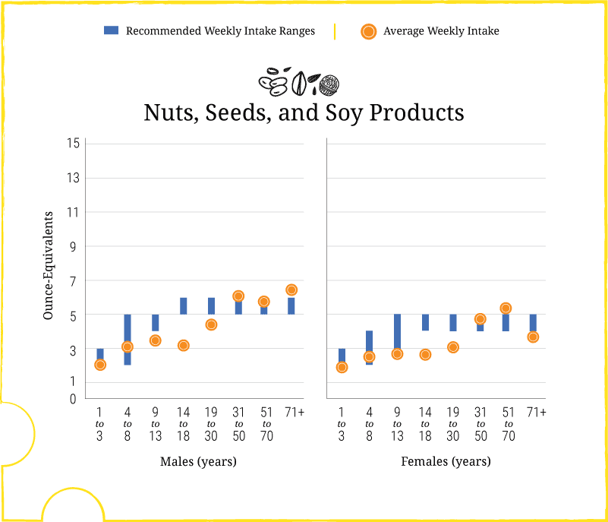
Nuts, Seeds, and Soy Products: Intakes and Recommendations
Average Weekly Intakes by Age-Sex Groups, Compared to Ranges of Recommended Intake (from Figure 2-6)
Data Sources:
What We Eat in America, NHANES 2007-2010 for average intakes by age-sex group. Healthy U.S.-Style Food Patterns, which vary based on age, sex, and activity level, for recommended intake ranges.
Notes:
Chapter 2 provides a number of figures to highlight current intakes compared to recommendations. Figure 2-6 includes a comparison of weekly intakes to recommendations for each protein foods subgroup across age-sex groups.
This section of the figure is for nuts, seeds, and soy products.
The blue bar represents the range of recommended weekly intake for nuts, seeds, and soy products. The orange dot indicates current weekly intakes of nuts, seeds, and soy products for each age-sex group.
Overall, average intakes of protein foods are close to amounts recommended for all age-sex groups (Figure 2-3, slide 33). However, this figure shows that the average intakes of protein foods subgroups vary in comparison to the range of intake recommendations.
Average intakes of nuts, seeds, and soy products are close to recommended levels.

Slide 58
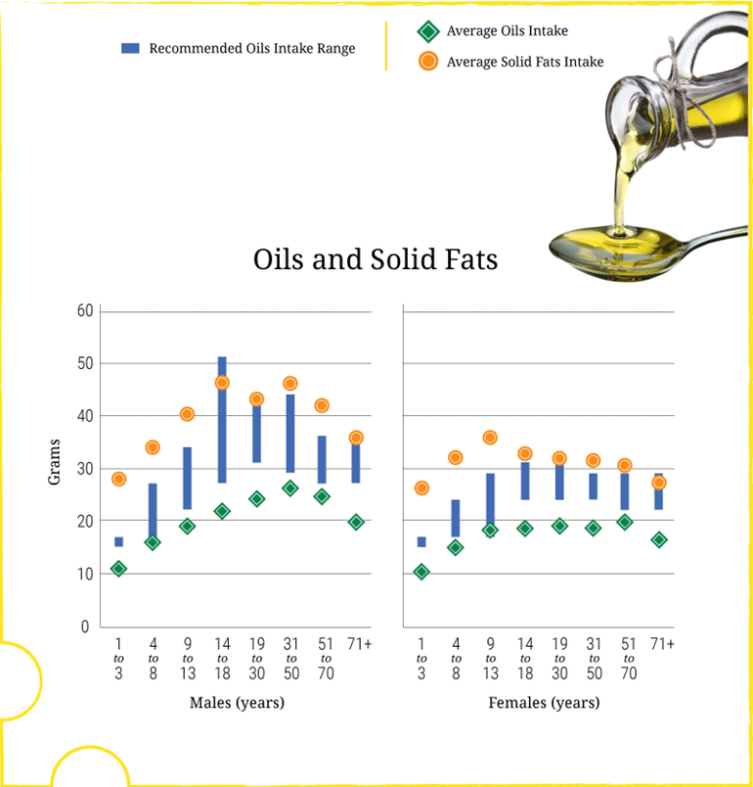
Oils and Solid Fats: Intakes and Recommendations
Average Intakes in Grams per Day by Age-Sex Group, in Comparison to Ranges of Recommended Intake for Oils (Figure 2-7)
Data Sources:
What We Eat in America, NHANES 2007-2010 for average intakes by age-sex group. Healthy U.S. Style Food Patterns, which vary based on age, sex, and activity level, for recommended intake ranges.
Notes:
Chapter 2 provides a number of figures to highlight current intakes compared to recommendations. Figure 2-7 includes a comparison of daily intakes of oils and solid fats to recommendations for oils across age-sex groups.
The blue bar represents the range of recommended intakes for oils. The green diamonds shows current intake of oils and the orange dots indicates current intakes of solid fats for each age-sex group.
Average intakes of oils are below the recommendations for almost every age-sex group. However, intakes are not far from recommendations. To move the intake of oils to recommended levels, individuals should use oils rather than solid fats in food preparation where possible.
A note on the terms saturated fats and solid fats:
The Guidelines describe the difference between the terms “saturated fats” and “solid fats.” Although they are closely related terms, saturated fats and solid fats are not synonymous. The term “saturated fats” refers to saturated fatty acids, a nutrient found in foods, while the term “solid fats” describes the physical manifestation of the fats in a food. Some solid fats, such as the strip of fat around a piece of meat, can easily be seen. Other solid fats are not so visible. For example, the solid fats in whole milk are suspended in the fluid milk by the process of homogenization.
The Dietary Guidelines provides recommendations on saturated fats as well as on solid fats because its aim is to improve the health of the U.S. population through food-based guidance. It includes recommendations on saturated fats because of the strong relationship of this nutrient to a health outcome (CVD risk). It includes recommendations on solid fats because they are abundant in the diets of the U.S. population, and reducing solid fats when making food choices is an important way to reduce saturated fats and excess calories.
The main shift message for oils is to: Shift from Solid Fats to Oils

Slide 59
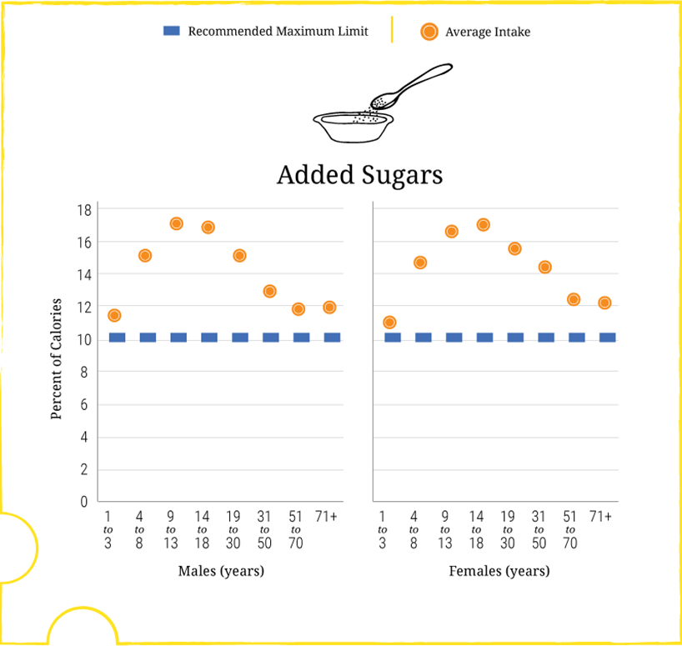
Added Sugars: Intakes and Limit
Average Intakes as a Percent of Calories per Day by Age-Sex Group, in Comparison to the Dietary Guidelines Maximum Limit of Less than 10 Percent of Calories (Figure 2-9)
Note: The maximum amount of added sugars allowable in a Healthy U.S.-Style Eating Pattern at the 1,200-to-1,800 calorie levels is less than the Dietary Guidelines limit of 10 percent of calories. Patterns at these calorie levels are appropriate for many children and older women who are not physically active.
Data Source: What We Eat in America, NHANES 2007-2010 for average intakes by age-sex group.
Notes:
Chapter 2 provides a number of figures to highlight current intakes compared to recommendations or limits. Figure 2-9 compares daily intakes of added sugars as a percent of calories across age-sex groups to the maximum limit of 10% of calories.
The blue dotted line represents the Dietary Guidelines limit. The orange dots show current intake of added sugars for each age-sex group.
Added sugars account on average for almost 270 calories, or more than 13 percent of calories per day in the U.S. population. As shown in this figure, intakes as a percent of calories are particularly high among children, adolescents, and young adults
The main shift message for added sugars is to: Shift to Reduce Added Sugars Consumption to Less than 10 Percent of Calories per Day

Slide 60
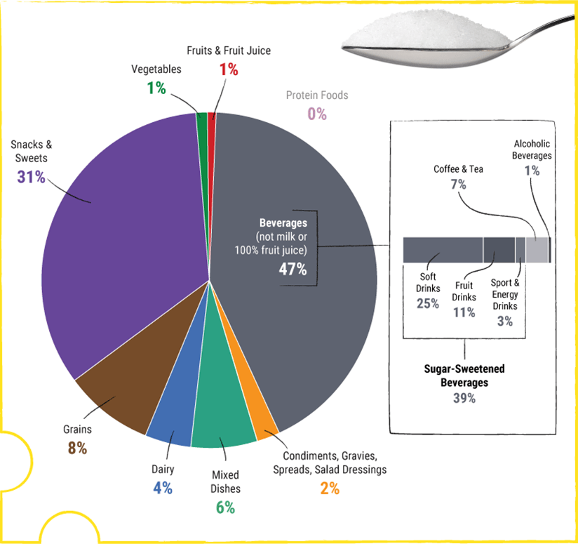
Food Sources of Added Sugars
Food Category Sources of Added Sugars in the U.S. Population Ages 2 Years and Older (Figure 2-10)
Data Source: What We Eat in America (WWEIA) Food Category analyses for the 2015 Dietary Guidelines Advisory Committee. Estimates based on day 1 dietary recalls from WWEIA, NHANES 2009-2010.
Notes:
Chapter 2 provides a number of figures to highlight current intakes compared to recommendations or limits. Figure 2-10 identifies the food categories that are sources of added sugars for the U.S. population.
This figure shows that the major source of added sugars in typical U.S. diets is beverages, which include soft drinks, fruit drinks, sweetened coffee and tea, energy drinks, alcoholic beverages, and flavored waters. Beverages account for almost half (47%) of all added sugars consumed by the U.S. population.
The other major source of added sugars is snacks and sweets, which includes grain-based desserts such as cakes, pies, cookies, brownies, doughnuts, sweet rolls, and pastries; dairy desserts such as ice cream, other frozen desserts, and puddings; candies; sugars; jams; syrups; and sweet toppings.
Together, these food categories make up more than 75 percent of intake of all added sugars.

Slide 61
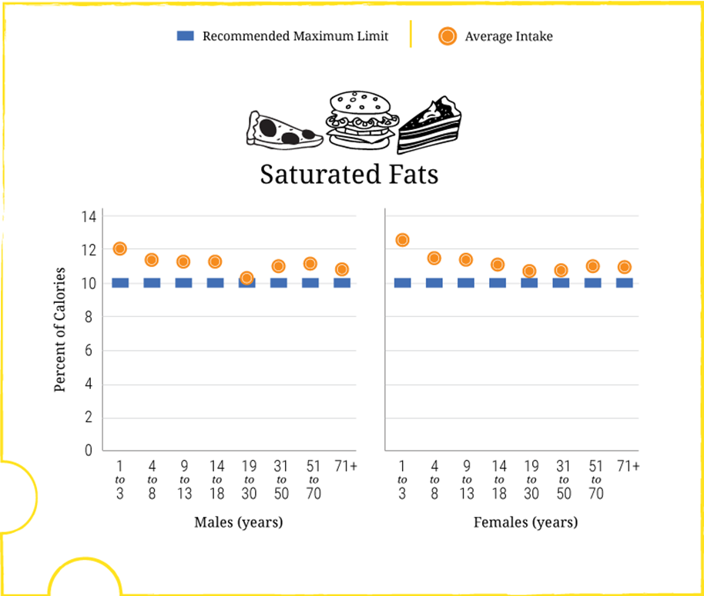
Saturated Fats: Intakes and Limit
Average Intakes as a Percent of Calories per Day by Age-Sex Group, in Comparison to the Dietary Guidelines Maximum Limit of Less Than 10 Percent of Calories (Figure 2-11)
Data Source: What We Eat in America, NHANES 2007-2010 for average intakes by age-sex group
Notes:
Chapter 2 provides a number of figures to highlight current intakes compared to recommendations. Figure 2-11 compares daily intakes of saturated fats as a percent of calories across age-sex groups to the maximum limit of 10% of calories.
Current average intakes of saturated fats are 11 percent of calories.
Only 29 percent of individuals in the United States consume amounts of saturated fats consistent with the limit of less than 10 percent of calories (shown in figure 2-1, slide 27).
This figure shows that average intakes do not vary widely across age-sex groups. Average intakes for both adult men and adult women are at 10.9 percent, and the average intake for children ranges from 11.1 percent up to 12.6 percent of calories.
The main shift message for saturated fats is to: Shift to Reduce Saturated Fats Intake to Less Than 10 Percent of Calories Per Day

Slide 62
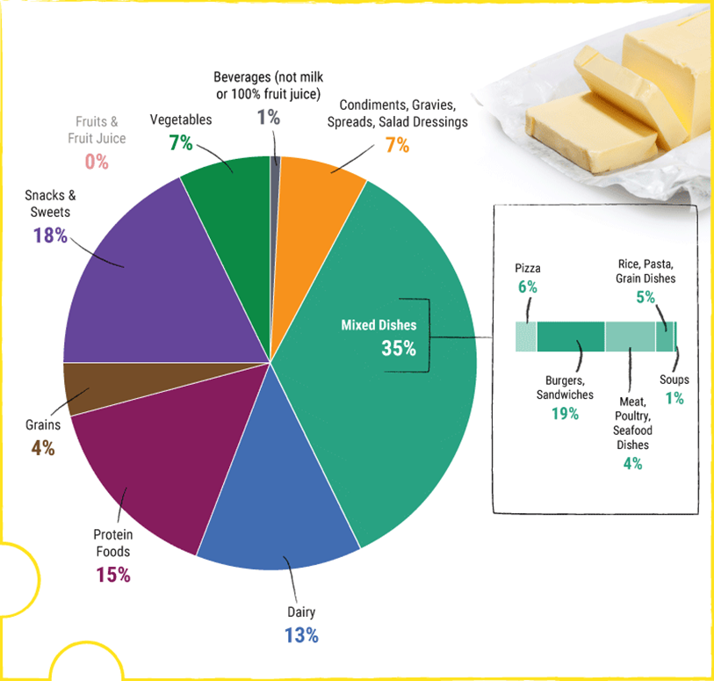
Food Sources of Saturated Fats
Food Category Sources of Saturated Fats in the U.S. Population Ages 2 Years and Older (Figure 2-12)
Data Source: What We Eat in America (WWEIA) Food Category analyses for the 2015 Dietary Guidelines Advisory Committee. Estimates based on day 1 dietary recalls from WWEIA, NHANES 2009-2010.
Notes:
Chapter 2 provides a number of figures to highlight current intakes compared to recommendations or limits. Figure 2-12 identifies the food categories that are sources of saturated fats for the U.S. population.
This figure shows that the mixed dishes food category is the major source of saturated fats in the United States, with 35 percent of all saturated fats coming from mixed dishes, especially those dishes containing cheese, meat, or both. These mixed dishes include burgers, sandwiches, and tacos; pizza; rice, pasta, and grain dishes; and meat, poultry, and seafood dishes.
The other food categories that provide the most saturated fats in current diets are snacks and sweets, protein foods, and dairy products.

Slide 63
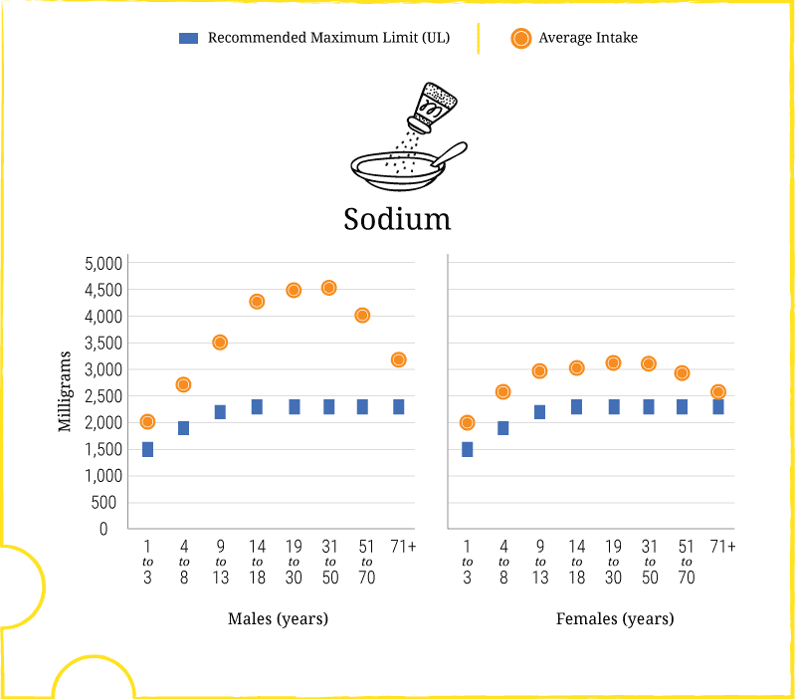
Sodium: Intakes and Limits
Average Intake of Sodium in Milligrams per Day by Age-Sex Groups, Compared to Tolerable Upper Intake Levels (UL) (Figure 2-13)
Data Sources:
What We Eat in America, NHANES 2007-2010 for average intakes by age-sex group. Institute of Medicine Dietary Reference Intakes for Tolerable Upper Intake Levels (UL).
Notes:
Chapter 2 provides a number of figures to highlight current intakes compared to recommendations. Figure 2-13 compares daily intakes of sodium across age-sex groups to Tolerable Upper Intake Levels (UL).
The blue dotted line represents the UL limit for each age group, set by the Institute of Medicine. The orange dots show current intake of sodium for each age-sex group.
This figure shows that average intakes of sodium are high across the U.S. population compared to the ULs.
Average intakes for those ages 1 year and older is 3,440 mg per day. Average intakes are generally higher for men than women.
For all adult men, the average intake is 4,240 mg, and for adult women, the average is 2,980 mg per day.
Only 11 percent of individuals in the United States consume amounts of sodium consistent with the UL limit (shown in figure 2-1, slide 27).
The main shift message for sodium is to: Shift Food Choices to Reduce Sodium Intake

Slide 64
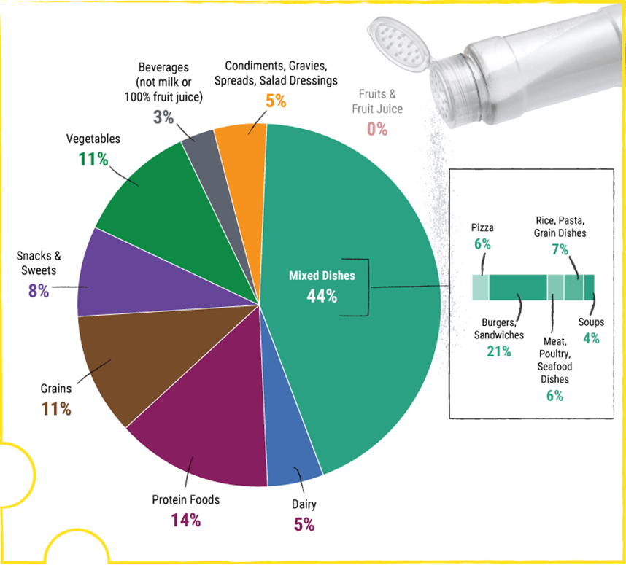
Food Sources of Sodium
Food Category Sources of Sodium in the U.S. Population Ages 2 Years and Older (Figure 2-14)
Data Source: What We Eat in America (WWEIA) Food Category analyses for the 2015 Dietary Guidelines Advisory Committee. Estimates based on day 1 dietary recalls from WWEIA, NHANES 2009-2010.
Notes:
Chapter 2 provides a number of figures to highlight current intakes compared to recommendations or limits. Figure 2-14 identifies the food categories that are sources of sodium for the U.S. population.
This figure shows that sodium is found in foods from almost all food categories. Mixed dishes—including burgers, sandwiches, and tacos; rice, pasta, and grain dishes; pizza; meat, poultry, and seafood dishes; and soups—account for almost half of the sodium consumed in the United States. The foods in many of these categories are often commercially processed or prepared.
Only a small proportion of total sodium intake is from sodium inherent in foods or from salt added in home cooking or at the table. Most sodium consumed in the United States comes from salts added during commercial food processing and preparation.

Slide 65

DietaryGuidelines.gov
Additional Resources:
Health.gov
ChooseMyPlate.gov

